Slide 1
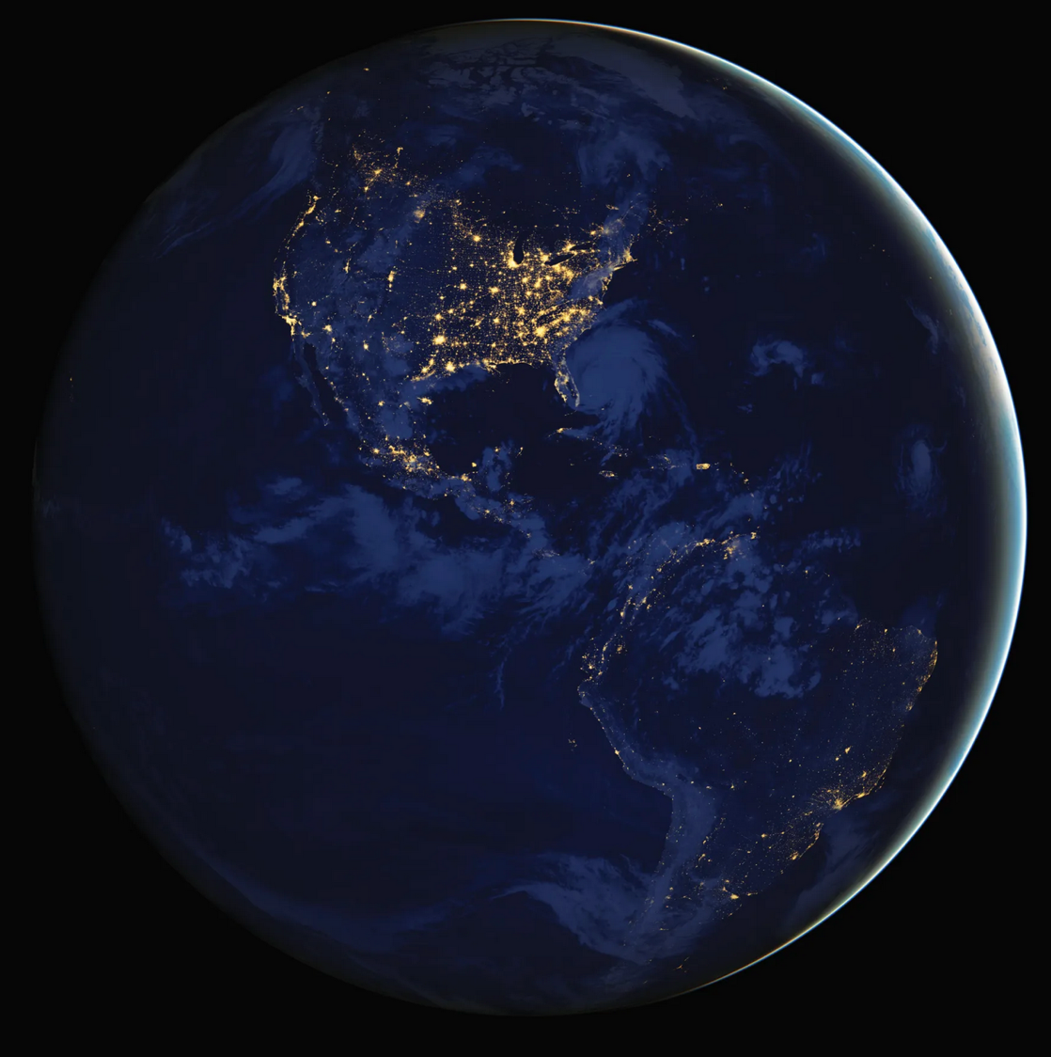
Dark Skies
Mitigate light pollution and protect our environment
Lincoln Dark Skies
Committee

Slide 2
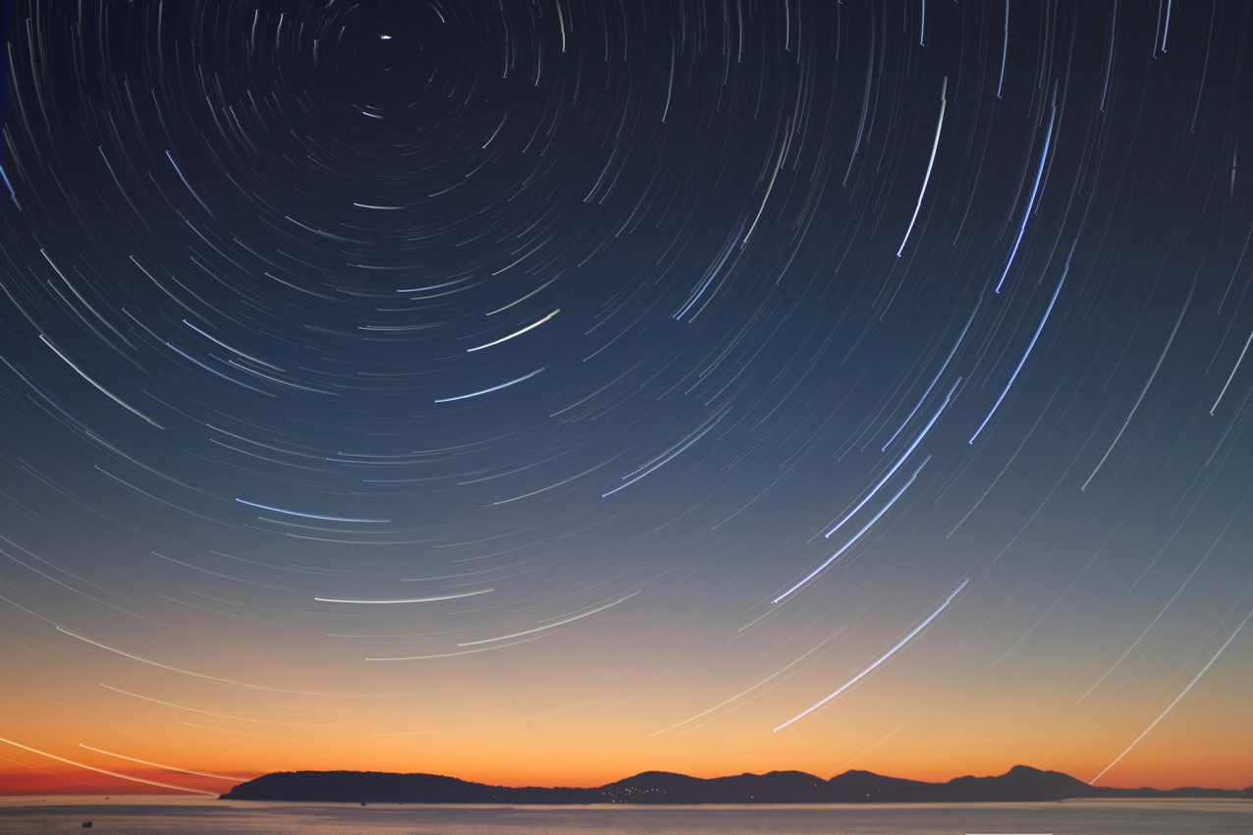
The Dark Skies Committee is a subcommittee of the Planning Board
https://www.lincolntown.org/252/Planning
Dark Skies nominatded Committee members
Louise Bergeron
Frank Clark
Buzz Constable
Sherry Haydock
Ken Hurd
Kathleen Lomatoski
Craig Nicholson
Diana Smith
Associates, Experts and Liaisons
Roy Harvey: Technical expert and energy Committee
Susan KatzSliski: Dark Skies advocate and school program
Diana Jong: LLCT and school program
Virginia Lemire: Commons
Robin Wilkerson: Common Grounds
Kathryn Walker: Writing and editing
Alan Sliski: Technical expert and Dark Skies advocate
Kim Bodnar: Select Board
Preserving Our Heritage
If I cannot move heaven, I will raise hell. (Virgil, Aeneid)

Slide 3
Content
Why control light pollution?
What are the concerns in Lincoln?
Solutions through Town policies, bylaws and education
Summary of outreach plan
Technical information on Dark Skies friendly lighting
Dark Skies Mission

Slide 4
Why control light pollution?
Support our ecosystems by improving the survival of mammals, amphibians, birds and insects
Protect our pollinators and improve food production on our farms
Enhance our safety and security
Protect our quality-of-life and human health
Reduce energy consumption
Enhance our ability to enjoy the starry night
The ravening clouds shall not long be victorious
They shall not long possess the sky, they devour the stars only in apparition,
Jupiter shall emerge, be patient, watch again another night, the Pleiades shall emerge. They are immortal.
(Walt Whitman, Leaves of grass)

Slide 5
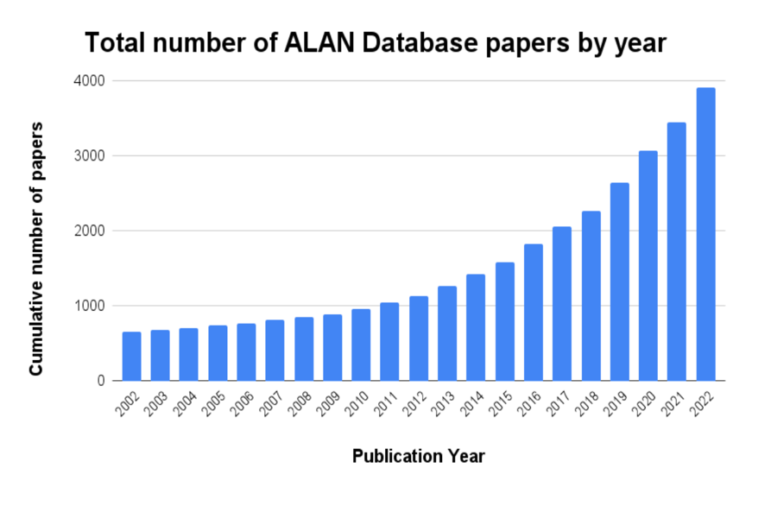
Emerging science since last bylaws update
Since the invention of the LED, blue color light similar to day light has proliferated dramatically.
LED technology is both a problem and a solution.
Scientific evidence on the effects of artificial light on human, animals and insects is mounting.
Bylaws update
ALAN: Artificial Light at Night
https://darksky.org/news/artificial-light-at-night-state-of-the-science-2023-report/
Earth-treading stars that make dark heaven light . (William Shakespeare, Romeo and Juliet)

Slide 6
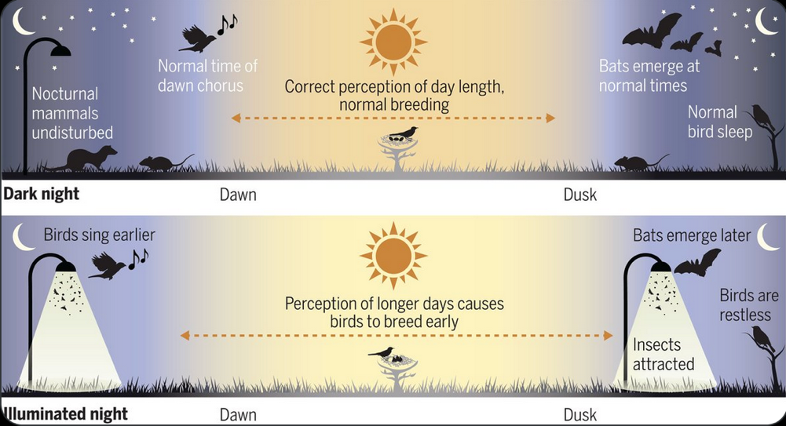
Artificial light at night harms our fauna
For billions of years, plants and animals have evolved with the earth cycles of night and day
In the last century, humans have perturbed that cycle, endangering ecosystems.
In the last twenty years, LED lights have brought daylight into the night.
All animals, whether nocturnal or diurnal depend on circadian cycles for survival.
Artificial light affects critical activities such as reproduction, foraging, hiding from predators, migration, and sleep.
Animals stay away from our artificial light resulting in a reduction of their habitat already in decline.
The glare of our lights interferes the nocturnal breeding activity of frogs, salamanders and toads and kill insects
Science Magazine, June 20, 2024
https://darksky.org/resources/what-is-light-pollution%20/effects/wildlife-ecosystems/
https://darksky.org/news/artificial-light-at-night-state-of-the-science-2023-report/
Notes:
We too quickly forget that we don’t perceive the world in the same way as other species, and consequently, we ignore impacts that we shouldn’t. (Ed Young, An immense world). . Unlike most other mammals, our vision fails us at night, and our culture reflects our diurnal Umwelt (ability to sense the environment.
The daily and seasonal rhythm of of bright and dark remained inviolate throughout all of evolutionary time –a-4-billion-year sneak that began to falter in the nineteenth century.
We have forced other species to live in our sensory world (umwelth), we have filled the night with light and the silence with noise. We have distracted animals from what they actually need to sense, drowned out the cues that they depend upon, and lured them, like moths to a flame, into sensory traps,

Slide 7
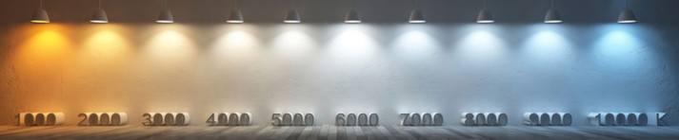
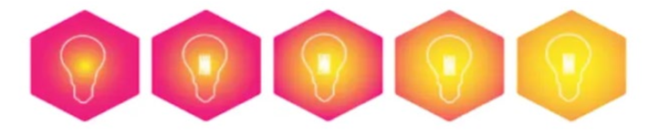
Light intensity and color
Light Color Temperature (Kelvin)
Light intensity (Lumens)
Color temperature describes the hue of the light, it is measured in degrees of Kelvin
Candle flame: 1800K
Incandescent: 2700K
Day light: 5000K
Blue sky: 8008-10000K
Blue rich light causes most glare and is the most disruptive to sleep and wildlife.
The light output of a source is measured in Lumens
Watts is the energy used to generate light.
A 9-watt LED is equivalent to a 60 watts incandescent bulb
How many lumens is needed depends use
200-500 lumens is considered sufficient to illuminate an entrance way
Lincoln’s outdoor lighting guidance restricts a light source to 900 lumens but does not limit the number of light sources
The illumination, measured in Lux, is what truly matters
https://darksky.org/news/why-is-blue-light-at-night-bad.
https://nvlightingga.com/blog/how-bright-should-outdoor-lighting-be
https://www.streetlights-solar.com/how-many-lumens-do-i-need-for-outdoor-lighting.html
Notes:
Red can disrupt migrating birds but is better for bats and insects. Yellow doesn’t bother insects and turtles but can disrupt salamanders. No wavelength is perfect, but blue and white are worst of all. Blue light disrupts body clocks and strongly attracts insects. It is easily scattered, increasing the spread of light pollution. (Ed Young, An immense world).

Slide 8
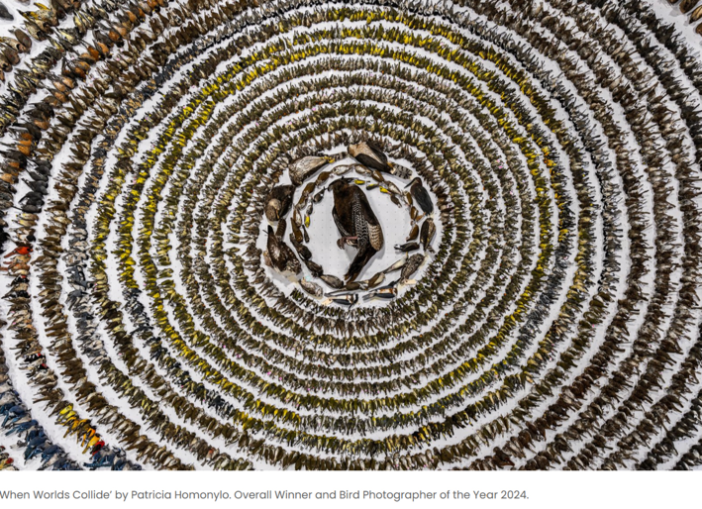
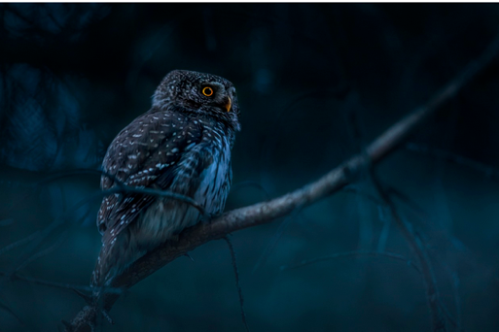
Birds need darkness to migrate and survive
80% of bird species migrate at night.
Artificial light disorients and attracts them. It causes birds to wander off course and hit buildings.
Among the one billion birds that die from flying into buildings in the USA each year, nearly half of them collide with homes and smaller buildings.
Owls are blinded by bright light; they stay away from artificial light which greatly limits their range.
“When words collide”, Patricia Homonyla.
Dead Birds that hit building during their migrations. The Smithsonian, 2016
https://flap.org/
https://darksky.org/resources/what-is-light-pollution%20/effects/wildlife-ecosystems/
https://darksky.org/news/artificial-light-at-night-state-of-the-science-2023-report/
https://www.pbs.org/newshour/science/how-light-pollution-can-imperil-migrating-birds-by-luring-them-into-cities
Notes:
In 1886, shortly after Edison commercialized the lightbulb, nearly 1000 birds died after colliding with electrically illuminated towers in Decatur, Illiniois. Over a century later, environmental scientist Travis Langcore and his colleagues calculated that almost 7 million birds a year die in the United State and Canada after flying into communication towers. The red light of those towers are meant to warn aircraft pilots, but the also disrupt the orientation of nocturnal avian flyers., which than causes them to veer into wire or each other.
Ed Young, An immense world.

Slide 9
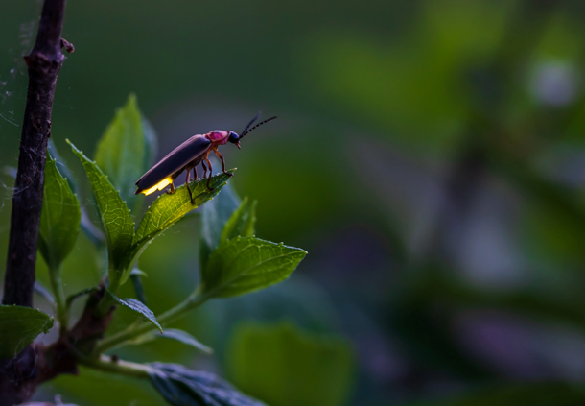
Lincoln farmers need the lights out
Pollinators and other insects require darkness at night for survival
The loss of pollinators affects our ability to produce food.
A study conducted in 2017 found that approximately 62% fewer insects visited the plants in a meadow illuminated at night with LED streetlamps than a meadow naturally lit by the moon.
Bees, which are diurnal, require darkness at night to forage effectively during the day
Insects critical to the survival of many other species such as birds and bats.
Nocturnal insects are fatally attracted to artificial light, leading to a serious decrease in their population.
Fireflies cannot mate under our artificial light with even red light affecting them. Fireflies can still be found in Lincoln, in our darkest farm fields.
https://darksky.org/resources/what-is-light-pollution%20/effects/wildlife-ecosystems/
https://darksky.org/news/artificial-light-at-night-state-of-the-science-2023-report/
There was a star danced, and under that I was born. (William Shakespeare, Much Ado About Nothing)

Slide 10
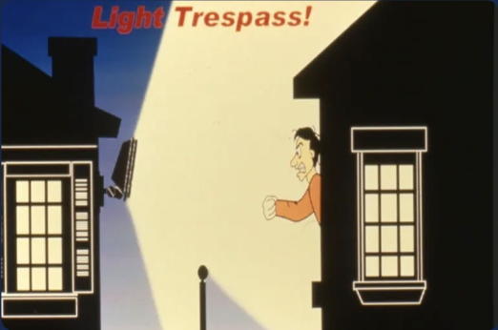
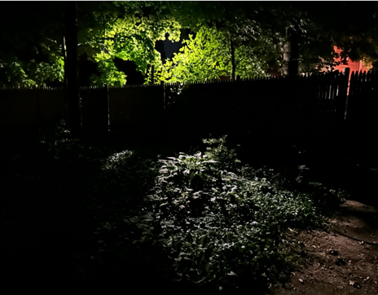
Artificial light at night is harmful to human health
Excessive light at night interferes with sleep patterns, and bright artificial light has been linked to an increased risk of stroke, Alzheimer’s disease and cancer.
Neighbors’ or streetlight illuminating large areas deprive residents from the experience of darkness on their own property.
Lincoln’s library illuminates a private garden
We’re All Healthier Under a Starry Sky, Mario Motta: https://images.clubexpress.com/71141/attach/3935311_1_JOE-MarioMottapeerReview-10-2-24.pdf
Mental and physical illness may be linked by a ‘broken’ circadian rhythm due to ALAN exposure. Su, K., et al. Brain, Behavior, Immunity – Health, Vol. 26, p. 100533.
Excessive night lighting, especially blue light, leads to myriad deleterious health effects: https://www.mariomottamd.com/street-lighting/
ALAN is associated with the prevalence of Alzheimer: https://www.frontiersin.org/news/2024/09/06/light-pollution-increase-risk-alzheimers
Exposure to artificial bright light is linked to higher risks of strokes: https://newsroom.heart.org/news/more-exposure-to-artificial-bright-outdoor-nighttime-light-linked-to-higher-stroke-ris
The stars are the jewels of the night, and perchance surpass anything which day as to show (Henry David Thoreau)
Notes:
Over a third of humanity and almost 80% of North Americans, can no longer see the Milky Way.

Slide 11
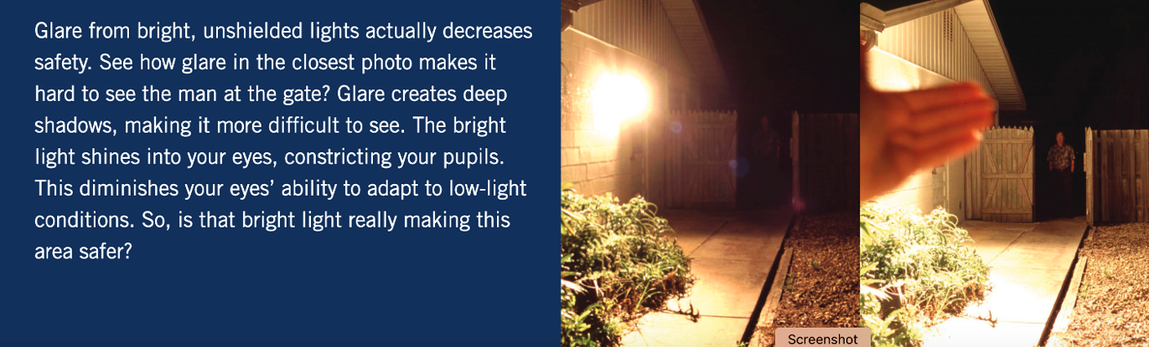
Safety and security: More is not better
Experts agree that there is no substantial evidence that lighter means safer. In fact, too much lighting and glare can negatively impact safety.
Lower intensity, consistent lighting, where and when needed, and motion-activated lighting would improve safety and security.
Switching off street lighting during overnight hours can reduce instances of theft from vehicles parked along streets. Tompson, L., et al.
Bright LEDs could spell the end of dark skies.https://www.technologyreview.com/2022/08/17/1057652/outdoor-led-lighting/
Streetlights effects on crime: https://www.theatlantic.com/ideas/archive/2024/09/streetlights-effect-on-crime/679652/
The stars that nature hung in heaven, and filled their lamps with everlasting oil, give due light to the misled and lonely traveler. (John Milton)
Notes:
Due to our diurnal nature, light has come to symbolize safety, progress, knowledge, hope ad n food. Darkness epitomizes danger, stagnation, ignorance, despair and evil. We crave light. It is jarring for us to think of light as a pollutant.

Slide 12
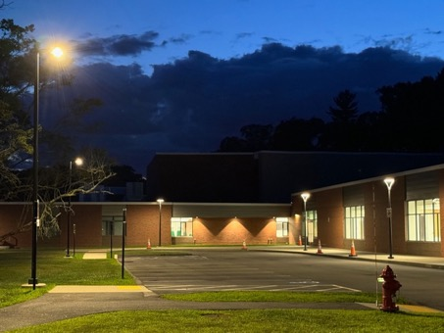
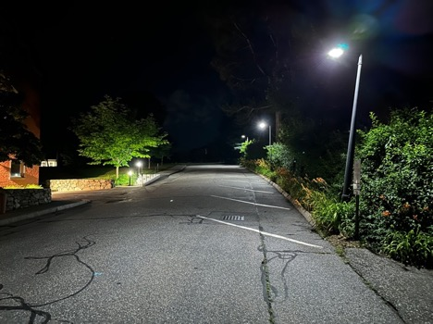
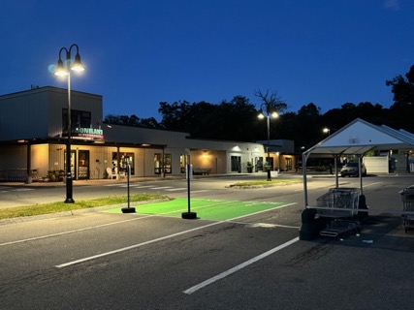
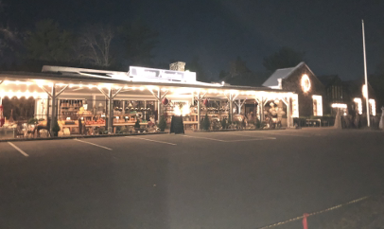
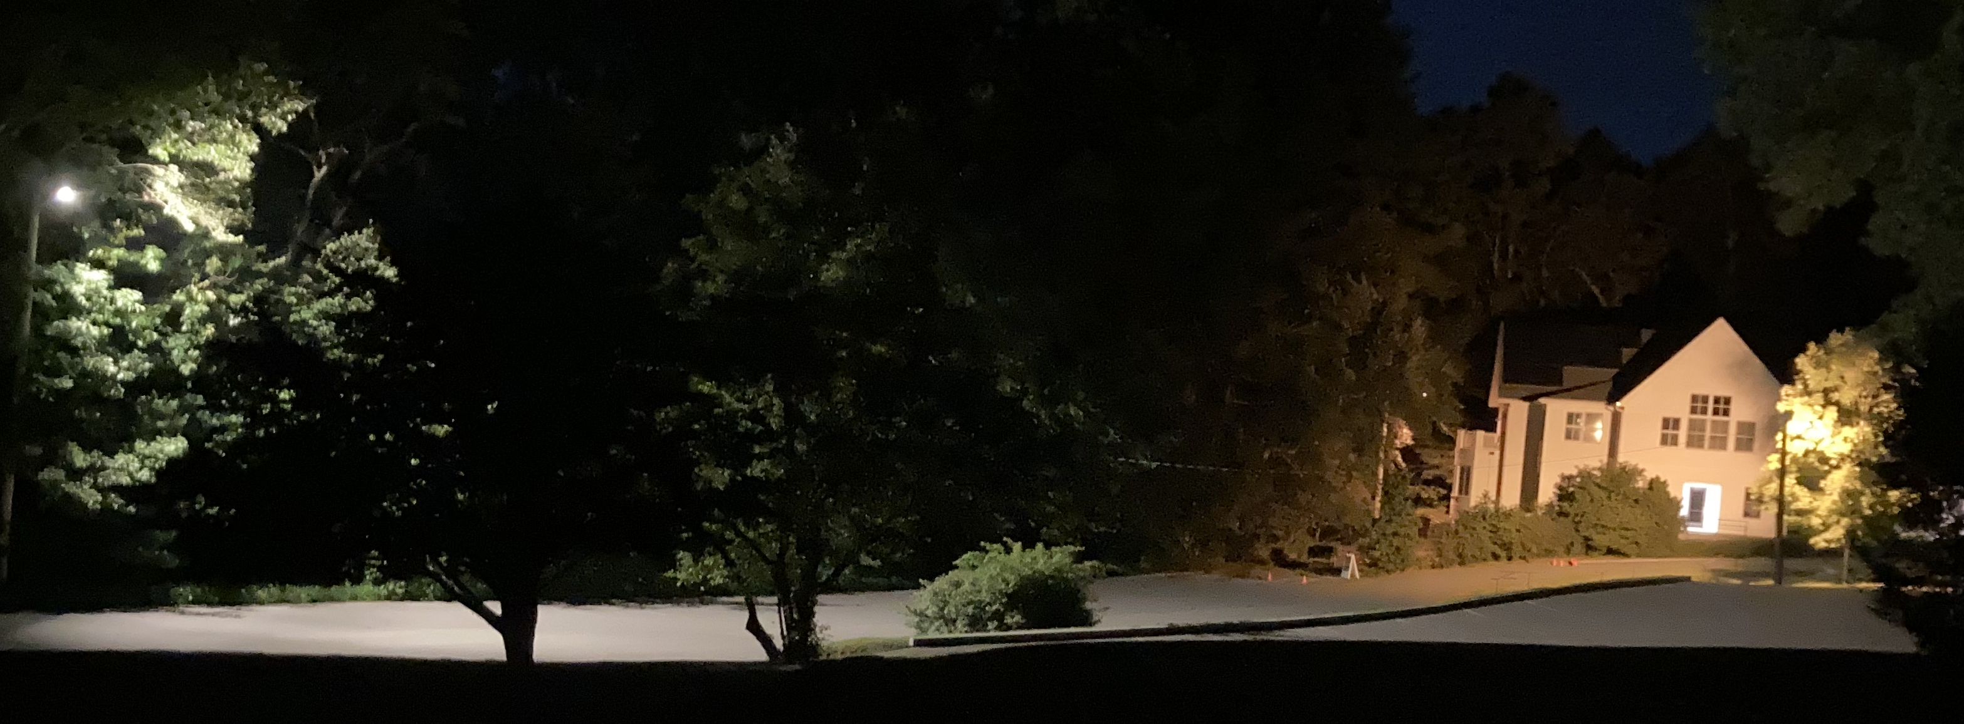
Some of the good and the to-be-improved in Lincoln
Good Examples
Codman Farms and estate (Fortunately, no picture could be taken because it is dark)
Some area of concerns
Institutions
School
Library
Some churches
South Lincoln mall area
Parking lots
Businesses
Streetlights
Private properties
Landscape lighting
Doorway and porch lights
Condo properties
Lincoln Ridge
Ryan Estate
When you reach for the stars you may not quite get one, but you won’t come up with a handful of mud either. (Leo Burnet)

Slide 13
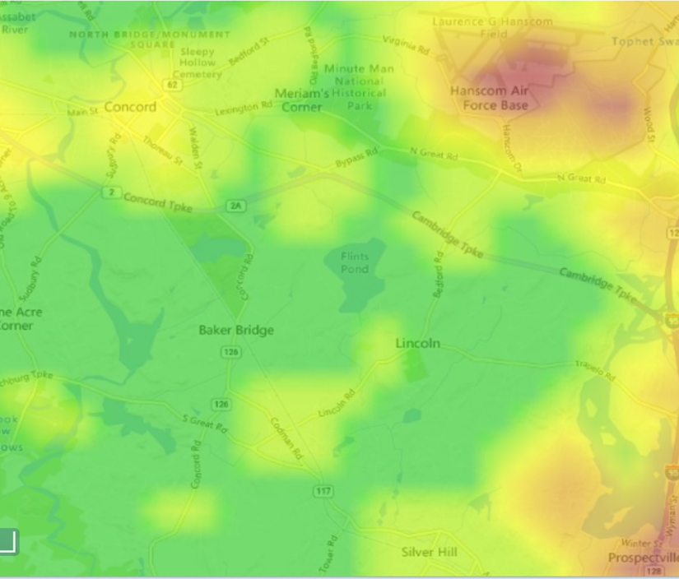
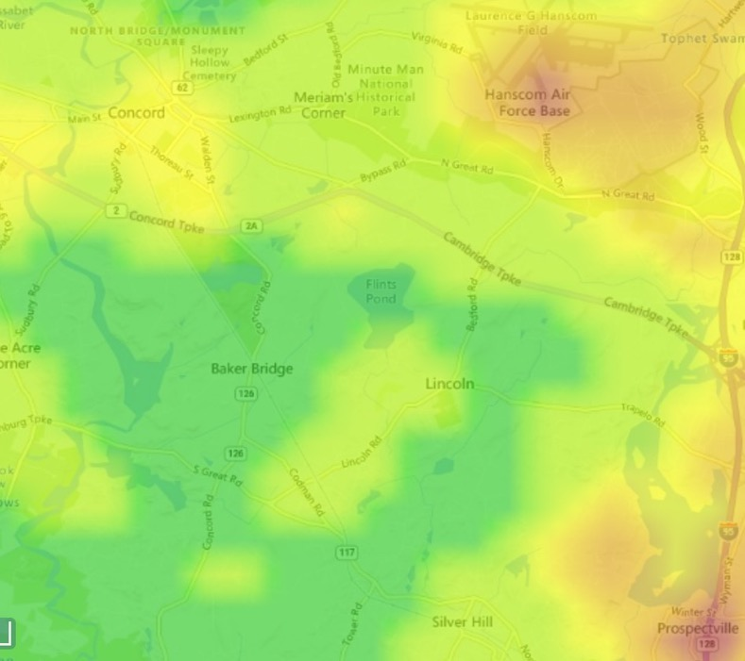
Have our current zoning bylaws been sufficient?
Light pollution has increased in Lincoln despite the adoption of new bylaws in 2012
Not only we have more light but more blue light
Development continues
What are the main problems? What can we do to improve the situation?
2013
2023
school

Slide 14
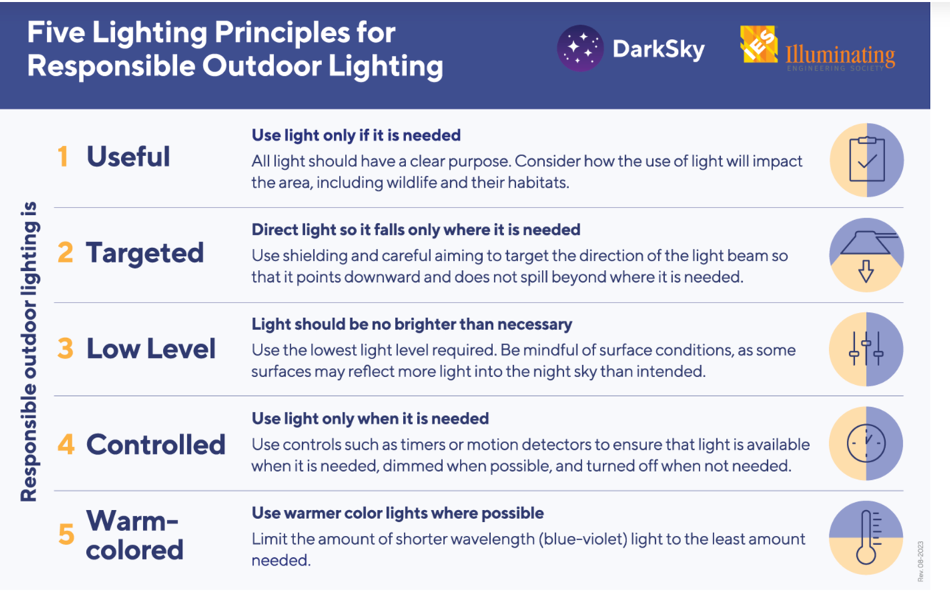
Apply International Dark Skies lighting guidelines
https://darksky.org/resources/guides-and-how-tos/lighting-principles/
Many a night I saw the Pleiades, rising thro’ the mellow shade, Glitter like a swarm of fireflies tangled in a sliver braid. (Alfred Tennyson)

Slide 15
Current guidelines versus considered lighting changes
Current
General Bylaw or town policies
Non-existent
Zoning Bylaw
Fixtures shielded to avoid up-lighting or off-site shining
Maximum color temperature 3000K
Existing fixtures prior top 2015 are exempt from this regulation
Guidance
Maximum intensity per fixture 900 Lumens
Driveway lighting not allowed; however, lighting in parking areas and walkways adjacent to a home may be allowed. Such lighting should be mounted no more than 3 feet above finished grade.
Considered
Public light (policies or bylaws)
Streetlights: fewer lights, color 2700K or lower, reduce intensity
Parking lots: Red light, 2500K or lower, motion activated from 100-900 lumens
Buildings: Lights off after hours, except for one light of 200-500 lumens at the entrance, 2700 K or lower.
General Bylaw applicable to all parcels (New)
Color temperature 2700K or lower
Turn off by 11:00 pm or turn at 9:00 pm with motion activation
Maximum 900 lumens, recommended 500 lumens in entrance way.
Parking and driveway, red light, 2500K or lower, motion activated 100-900
Fixtures shielded to avoid up-lighting or off-site shining
Commercial and Institutional properties should have all signs visible from outside the structures meeting the Guidelines or other requirements of zoning regulators.
Special events and exceptions permitted by the planning Board in the best interest of the public
Landscape lighting : TBD
5 years to comply
Zoning Bylaw
Variance, or site plan approval should comply with general bylaw.

Slide 16
Draft Dark Skies Plan Outline
PUBLIC LIGHTS [Note: all of the bullets in this section could be accomplished administratively now or included in a bylaw.]
Lighting in Publicly Owned Parking and recreation Areas and Exterior to Buildings
Streetlights
Interior Lights on Public Buildings
GENERAL BYLAW APPLICABLE TO ALL PARCELS (except state, federal and state-wide authorities)
New Construction or Installation
Existing Structures and Fixtures
The Board of Selects may waive or suspend Dark Skies requirements for an emergency or for an event or condition when, after a public hearing, it determines such waiver or suspension to be in the public interest.
ZONING BYLAW
The Zoning Bylaw would provide that applications subject to a special permit, variance, or site plan approval shall comply with the Dark Skies Bylaw.
The Planning Board and Zoning Board of Appeals would retain its jurisdiction, including discretion to impose additional conditions that relate to lighting.
The Zoning Codes Enforcement officer would be the primary enforcement officer, with appeals from their decision to be made to the Zoning Board of Appeals as currently provided for zoning matters.
EDUCATIONAL RESOURCES
The Town would make available a list of the best dark skies lighting fixtures and retrofits with approximate costs for anyone who wants to look, including applicants for zoning approvals. Update the list at least every two years.
The Town would provide educational materials for homeowners moving to Lincoln, a la LLCT/ConsCom.

Slide 17
Guidance from experts and model bylaws
Experts who provided resource and guidance
Glenn Heinmiller: Professional lighting designer, co-author of the statewide Dark Sky Bill now pending in the legislature, helped write Nantucket's new lighting bylaw.
Tim Brothers: Astronomer at MIT's Wallace Observatory in Westford, resident of Pepperell and co-author of the Dark Sky Bill.
Leo Smith: Member of Illuminating Engineering Society, author of DarkSky International's Model Lighting Bylaw
Jane Slade: Professional lighting designer in Mass., very familiar with dark-sky principles
James Lowenthal : Professor of Astronomy, Smith College. Consulting on lighting bylaws for the towns of Pelham, Amherst, Northampton. Working with DarkSky International to develop a new municipal lighting bylaw template.
Gail Walker: Heads Nantucket Light. Expertise in advocacy and bylaw writing.
Key documents that can serve as models of bylaws, town policies and education campaigns
Nantucket: Bylaws and Educational materials
Outdoor Lighting Bylaw for Pepperell MA
Model of Outdoor Lighting Regulation, 2024 CT
MA-Contemporary Outdoor-Lighting Bylaw v1.0 2023-08-25
Macte virtute, sic itur ad astra. Excellence is the way to the stars. (Virgil, Aeneid)

Slide 18
Lincoln’s current exterior lighting bylaws and guidance
Bylaws
13.5 Exterior Lighting: All artificial lighting permanently installed in any district, shall consist only of fully shielded light fixtures and be so installed or shielded as to prevent direct light or glare from the light source from interfering with the vision of motorists or pedestrians passing in the street or streets abutting the premises and as to prevent direct light or glare from illuminating neighboring properties.
13.5.1 All exterior lamps shall have a Correlated Color Temperature (CCT) value of 3000K or below.
Guidelines for exterior lighting (Additional items added in 2015)
Exterior lighting on structures will be allowed only where required by the Massachusetts Building Code or where the Planning Board determines that lighting is needed to enhance safety of occupants or visitors.
Individual light fixtures shall not exceed 900 lumens.
Exterior lighting of structures or landscape for architectural or aesthetic effect is not permitted.
Driveway lighting will not be allowed; however, lighting in parking areas and walkways adjacent to a home may be allowed. Such lighting should be mounted no more than 3 feet above finished grade.
To identify street numbers, reflective numbers on mailboxes are preferred. In unusual circumstances, the Planning Board may allow lighting of street numbers placed on the exterior of a residence or on a plaque or bollard placed near the street.
Existing fixtures prior top 2015 are exempt from this regulation

Slide 19
List of questions to help identify options for specific sites
How many fixtures are there?
Do the fixtures meet a dark-sky spec such as DLC LUNA (https://designlights.org/wp-content/uploads/2022/09/DLC_LUNA-Technical-Requirements-V1-0-FINAL_09072022.pdf )
How many lumens per fixture?
What color temperature?
What technology light source (LED, metal halide, etc)?
What level of illuminance or luminance did the system target, and what level is it running at?
Are the fixtures controlled as one group, more than one group, or individually?
Is the control manual, by timer/schedule, or by light sensor?
Is the control on/off or are there levels of dimming?
If the fixtures do not have individual controls, are the fixtures control-ready?
Macte virtute, sic itur ad astra. Excellence is the way to the stars. (Virgil, Aeneid)

Slide 20
Dark Skies friendly lighting
Design Lights Consortium (DLC)'s Luna project for dark-sky-friendly lighting:
https://designlights.org/our-work/luna/
Qualified Products List (QPL). DLC lists all the products that meet their specs and that manufacturers have paid them to list. You can search on many criteria to select a light fixture that meets your specific application. Check boxes for “LUNA Technical Requirement”, ”
https://qpl.designlights.org/qpl/solid-state-lighting
Comprehensive database designed for professionals (Not easy to use for consumers but very useful)
https://designlights.org/our-work/luna/technical-requirements/luna-v1-0/
For light bulbs where you can can select products with specific color temperature values.
www.1000bulbs.com.
White paper showing how to design lighting that minimizes light pollution.
https://designlights.org/resources/reports/choosing-both-energy-efficiency-and-light-pollution-mitigation-for-commercial-outdoor-lighting/
Macte virtute, sic itur ad astra. Excellence is the way to the stars. (Virgil, Aeneid)

Slide 21
Video to watch
Presentations from James Lowenthal, Smith College
https://www.youtube.com/watch?v=MlHp-B0DTMw
https://www.youtube.com/watch?v=k_mZignBh6c
https://www.youtube.com/watch?v=bfQaGg8abeo
Presentation from Tim Brothers
https://www.youtube.com/watch?v=R8HKaye8Uog
Contact the Lincoln Dark Skies Committee:
craig Nicholson NicholsonC@lincolntown.org
Macte virtute, sic itur ad astra. Excellence is the way to the stars. (Virgil, Aeneid)

Slide 22
Dark Skies mission
Honoring its history as a rural, by-right farming community and its legacy of leadership in land conservation, Lincoln seeks through education and practice to further protect the natural environment by better understanding and mitigating the adverse effects of excessive artificial light on the natural world and its nocturnal wildlife.
Drawing upon both scientific research and the lived experience as a mixed suburban/agricultural community, the Town aspires to be a municipal leader in embracing the principles of the Dark Sky initiative by using a commonsense approach to preserving and protecting the night sky ambience that enhances the general well-being of residents as well as Lincoln’s nocturnal wildlife. Adopting current best practices of exterior lighting will only amplify the Town’s commitment to maintaining a more natural, sustainable environment in which all inhabitants including flora and fauna may thrive.
National Geographics
International and MA Dark Sky initiatives
https://darksky.org/
https://darkskymass.org/about-us/idas-massachusetts-chapter/

Slide 23
Dark Skies purpose
In accordance with our Mission Statement, current and future outdoor lighting systems should be designed, constructed, installed, and maintained to:
Minimize light pollution and especially blue light, to the greatest extent possible in all outdoor lighting, as it is known to cause negative effects on human health, road visibility, agricultural yields, the well-being of birds that migrate at night as well as all the nocturnal organisms, including pollinators, bats, turtles, fish and amphibians, especially salamanders, frogs and toads.
Protect residents from unwanted light, or light trespass, that negatively affects the enjoyment of their own property, including their property values.
Control and mitigate glare to increase the safety and security of residents, visitors, motorists, pedestrians and our nocturnal inhabitants, all of which can be blinded and disoriented by undue glare.
Provide adequate light for the safe performance of outdoor tasks at night.
Preserve the historic and rural character of Lincoln for current and future generations.
Minimize skyglow to preserve the ability to see the stars, the constellations and the Milky Way galaxy against a dark sky, thus allowing the ancient art of star gazing that has captured the imagination of every culture since time began for humans on earth.
Promote efficient and cost-effective lighting to conserve energy.
National Geographics

