Slide 1
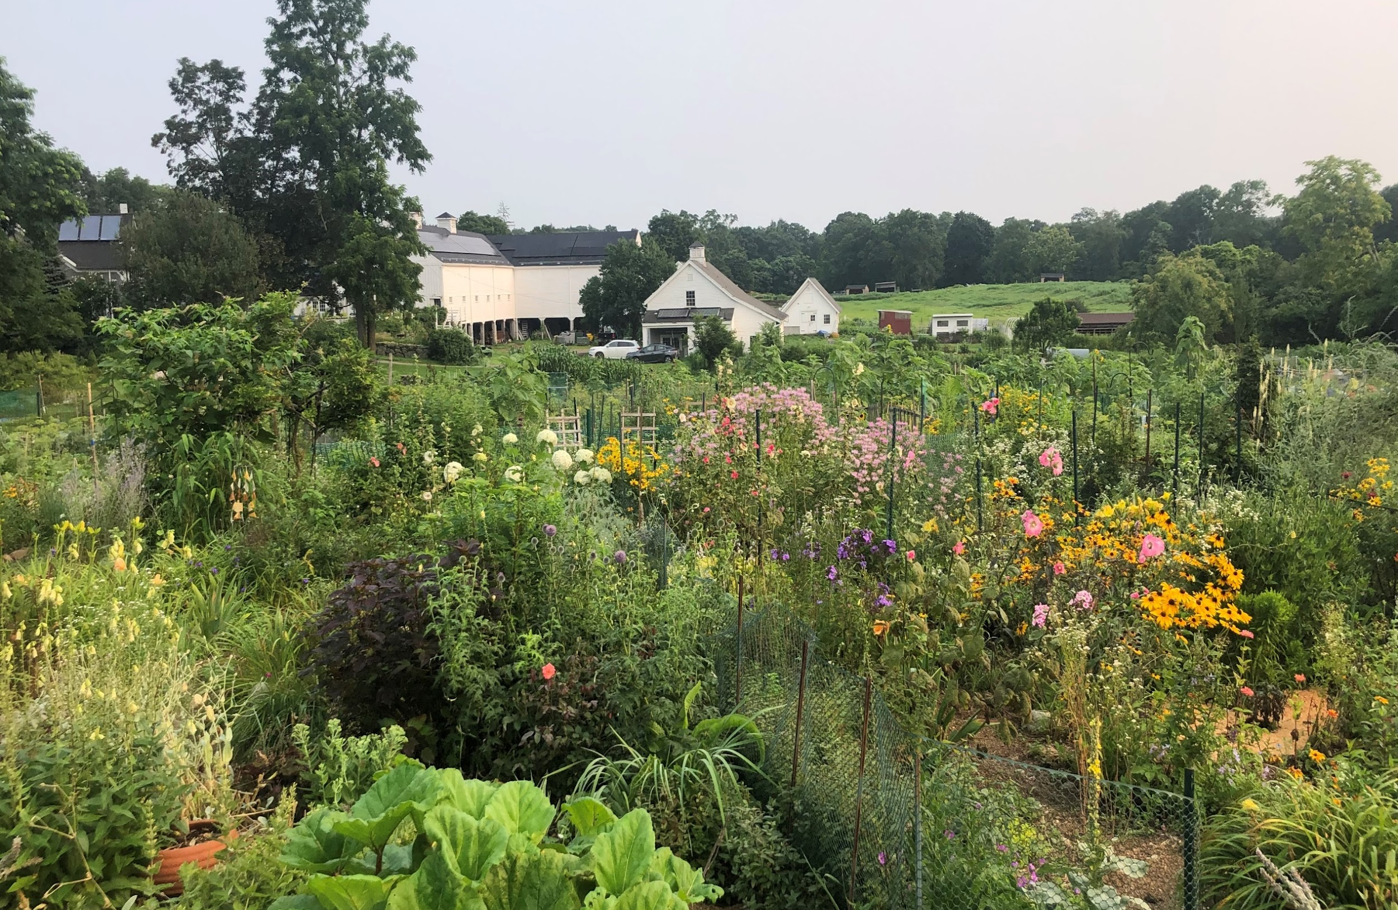
Lincoln Climate Action Plan
Select Board Meeting – February 5, 2024
Image from Michele Grzenda

Slide 2





Tonight’s Meeting
Plan Overview
Feedback
MVP 2.0
Green Energy Coaches
Next Steps

Slide 3
Stakeholders Engaged
Town Departments
Building & Engineering
Conservation
Council on Aging and Human Services
Planning and Land Use
Highway
Public Works
Public Safety
Town Administration
Water
Boards and Committees
Agricultural Commission
Bicycle and Pedestrian Advisory Committee
Board of Health
Climate Action Lincoln
Conservation Commission
Green Energy Committee
Historic Commission
Housing Commission
Inclusion, Diversity, Equity, Anti-Racism Committee
Lincoln School Committee
Planning Board
Roadway and Traffic Committee
Select Board
Zoning Board of Appeals
Community and Resident Groups
Friends of Modern Architecture
Lincoln Common Ground
Lincoln Land Conservation Trust
Lincoln Parent Teacher Organization
Lincoln-Sudbury High School Environmental Club
Mothers Out Front
Rural Land Foundation
The Commons in Lincoln
Zero Waste Lincoln
Welcome, Inclusion, Diversity, Equity (WIDE)

Slide 4
Climate Action Lincoln
Sue Klem (Chair)
Edward Kern
Emily Haslett
Lynne Smith
Roy Harvey
Staci Montori
L-CAP Working Group
Abigail Butt, Director Council on Aging & Human Services
Donald Fonseca, Housing Commission
Jane O’Rourke, Council on Aging & Human Services Board, Social Worker
Jena Salon, WIDE
Jennifer Glass, Select Board, IDEA
John MacLachlan, Lincoln School Committee
Kim Rajdev, Lincoln School Committee
Margaret Olson, Planning Board, Bicycle & Pedestrian Advisory Committee, Roadway and Traffic Committee
Michele Grzenda, Conservation Director
Michelle Barnes, Water Commission, Rural Land Foundation, Lincoln Land Conservation Trust
Rachel Neurath, Lincoln Common Ground
Roy Harvey, Climate Action Lincoln, Green Energy Committee
Sue Klem, Climate Action Lincoln, Green Energy Committee
Trish O’Hagan, Mothers Out Front and Zero Waste Lincoln

Slide 5
What Does the L-CAP Do?
Implements resilience and mitigation efforts with an equity focus
Establishes climate action goals for the community
Identifies strategies to help meet the established goals

Slide 6
Lincoln's Climate Goals
Carbon neutrality
Accessibility, walkability, and connectivity
Protect Lincoln’s agricultural, historic, and environmental resources
Ensure residents are prepared to deal with major climate hazards
Waste reduction and recycling
Mitigation and sustainability for buildings and homes
Align local efforts with the State climate goals

Slide 7






Strategy Development - 6 Sectors
Energy
Mobility
Built Environment
Working Lands and Natural Resources
Water and Solid Waste Management
Social Resilience and Education

Slide 8
Criteria for Strategy Prioritization
Greenhouse Gas (GHG) Reduction Potential
Equity Consideration
Co-benefit Potential
Enhance Adaptive Capacity and Resilience
Level of Effort to Implement
Cost to Implement – for town or residents

Slide 9
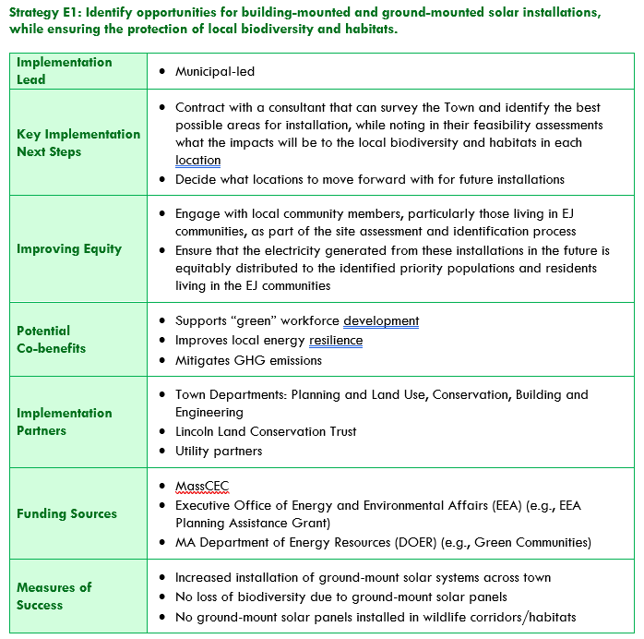
Implementation Roadmap Example

Slide 10
Feedback
  Promote composting program at Transfer Station
  More dedicated bike lanes
  Public EV chargers
  Safer pedestrian crossings
  Promote Lincoln Green Energy Choice
  Hanscom expansion

Slide 11
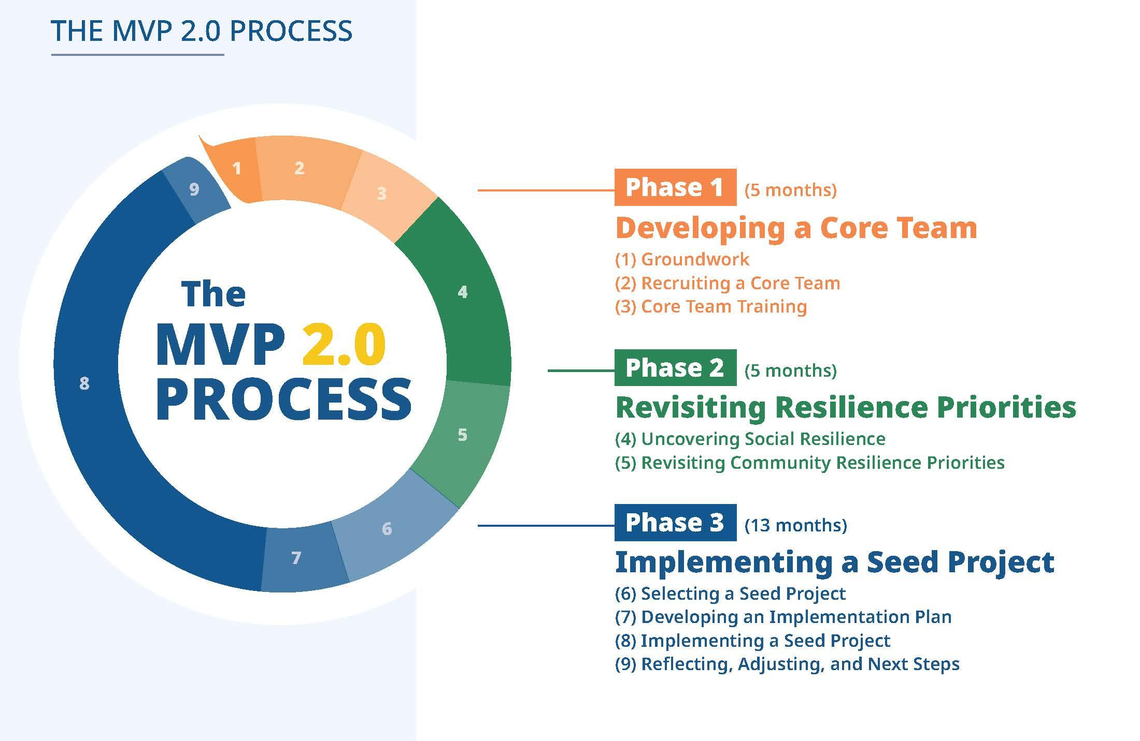

Slide 12
Green Energy Coaches Program
Resident volunteers
Assistance accessing funding
Connecting with contractors
Providing general information and advice
Specialize: Electric vehicles, Weatherization, Heat Pumps, Solar panels, etc.

Slide 13



Next Steps
Select Board Plan Acceptance
Implementation
Further data gathering and strategy analysis

Slide 14

Questions?

