Slide 1
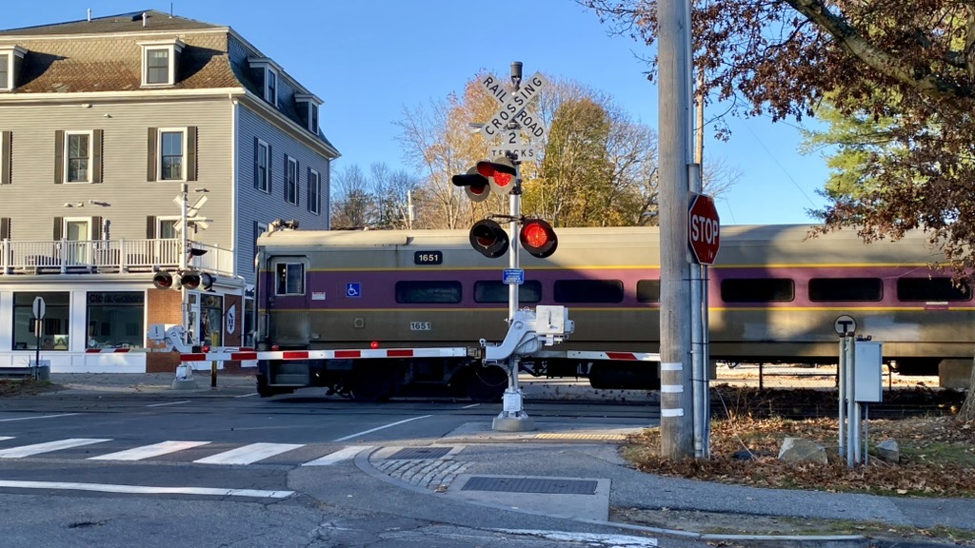
The Housing Choice Act – Lincoln’s Path Forward
Multi-Board Meeting
Tuesday, June 6, 2023

Slide 2
This presentation will cover…
Context
Compliance requirements for Lincoln
Timeline for compliance
Developing parameters for compliance options
Analysis of district options
HCA & Inclusionary Zoning
Proposal for Village Center Mall Subdistrict
Q&A
Next Steps

Slide 3
Working Group Members
Michelle Barnes Lincoln Land Conservation Trust
Abigail Butt, Director Council on Aging & Human Services
Bill Churchill Zoning Board of Appeals
Rachel Drew Housing Commission
Bob Domnitz Planning Board (until end of March 2023)
Steve Gladstone Water Commission (beginning April 2023)
Andrew Glass Historical Commission
Jennifer Glass Select Board
Tim Higgins Town Administrator
Darin LaFalam Superintendent, Water Department
John MacLachlan School Committee
Geoff McGean Rural Land Foundation
Craig Nicholson Planning Board (beginning May 2023)
Terry Perlmutter Council on Aging & Human Services Board
Kathleen Shepard Conservation Commission
Gary Taylor Planning Board
Paula Vaughn-MacKenzie Director of Planning and Land Use

Slide 4
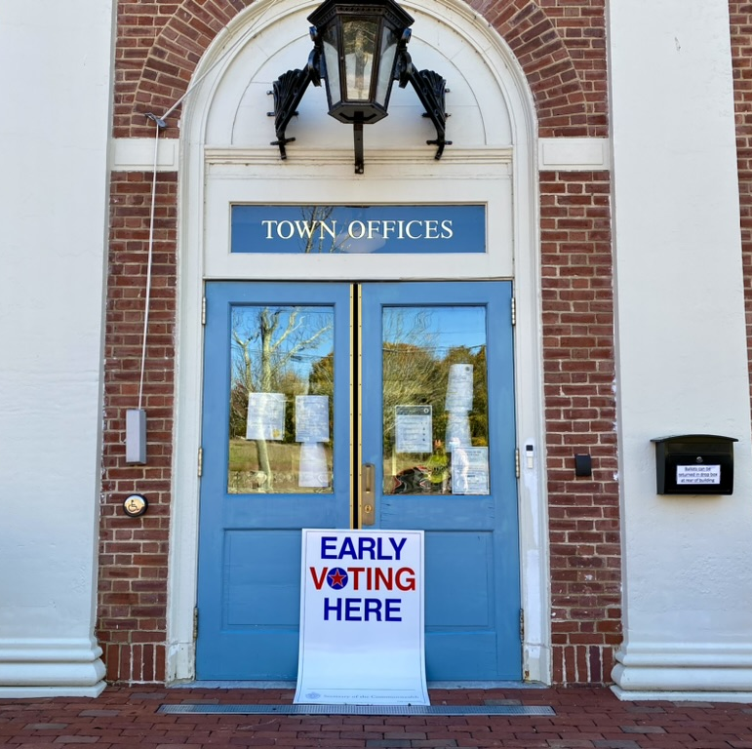
Town Vision Statement
Lincoln is committed to…
“Fostering economic, racial, ethnic, and age diversity among its citizenry through its educational, housing and other public policy.”

Slide 5
Context
“All MBTA Communities must comply with the Law. Communities that do not currently have a compliant multi-family zoning district must take steps outlined in the DHCD guidelines to demonstrate interim compliance. Communities that fail to comply with the Law may be subject to civil enforcement action. Non-compliant MBTA Communities are also subject to the administrative consequence of being rendered ineligible to receive certain forms of state funding. Importantly, MBTA Communities cannot avoid their obligations under the Law by foregoing this funding. The Law requires that MBTA Communities “shall have” a compliant zoning district and does not provide any mechanism by which a town or city may opt out of this requirement.”
- March 15, 2023, ruling from the Attorney General
Housing Choice Act was signed into law in 2021; compliance is not optional
Section 3A of the law applies to 175 cities and towns that have or are adjacent to MBTA service
Commuter rail towns must approve a compliant district by December 2024

Slide 6
Timeline
Fall 2022
Dec 2022
Jan 2023
Lincoln submits interim compliance plan
Select Board appoints HCAWG
Lincoln awarded grant to hire Utile for technical assistance
June 2023
Public forums: Solicit feedback on options for compliance to finalize districts
June 16 Public Forum – IN PERSON
Sept 2023
State of the Town September 30th
Present draft zoning bylaw; get community feedback
Mar 2024
TOWN MEETING VOTE ON ZONING BYLAW
Dec 2023
Submit HCA district model and zoning bylaw language to DHCD for pre- approval
If approved, at Town Meeting, submit to DHCD and Attorney General
Dec 2024
Deadline for Commuter Rail towns to comply
Lincoln’s interim plan approved by state! Lincoln is currently in compliance with the HCA
June 20 Public Forum – via ZOOM
June 6th – Multi-Board Meeting

Slide 7
HCA Requirements for Lincoln
Zoning vs. Production = HCA is focused on zoning
District must be a minimum of 42 acres
“By right” zoning of at least 15 units/acre across the district
Total zoning unit capacity requirement for Lincoln is 635 units
20% of district must be within 0.5 miles of the MBTA station
Subdistricts are allowed
Each subdistrict must be at least 5 acres
One subdistrict must be at least half of the total district
HCA aimed at residential zoning, commercial use cannot be required in a compliant district
Notes:
During the presentation note that the capacity is a theoretical capacity and does not need to be built

Slide 8
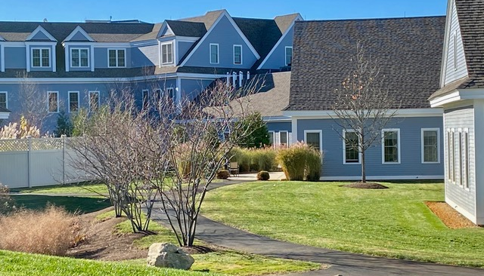
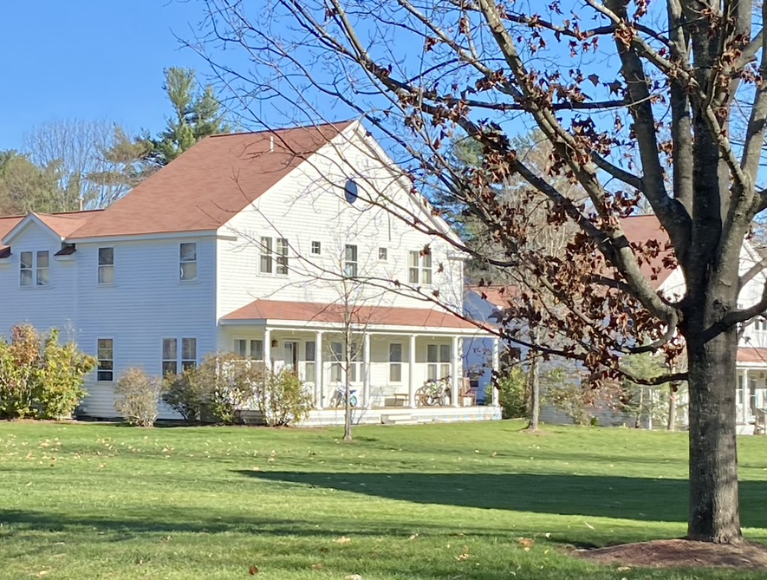
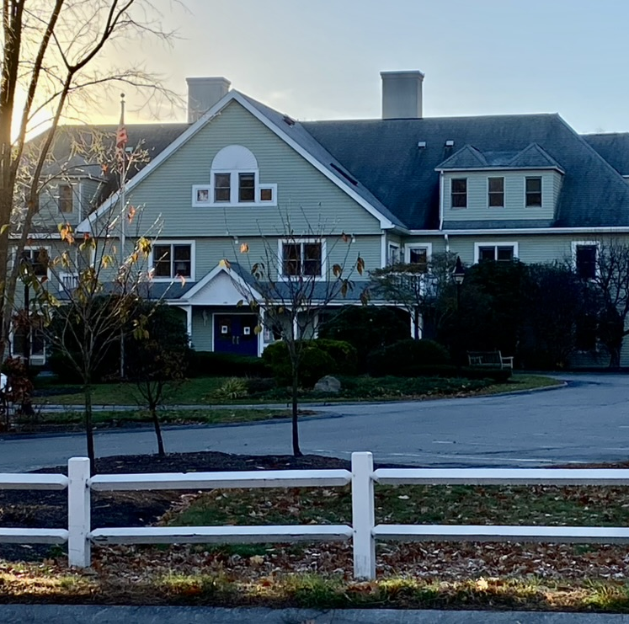
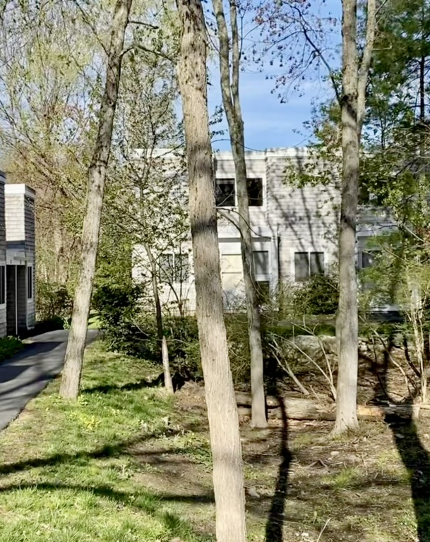
A Starting Point Towards Compliance
Area within ½ mile of the MBTA Train Station
Area within ½ mile of MBTA Bus Stops on Hanscom Drive
Look at areas in Lincoln that already have multi-family housing

Slide 9
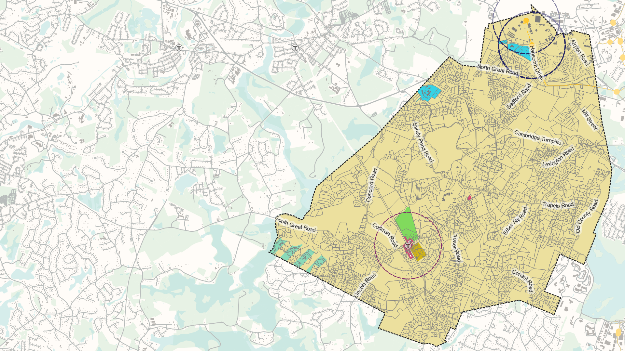
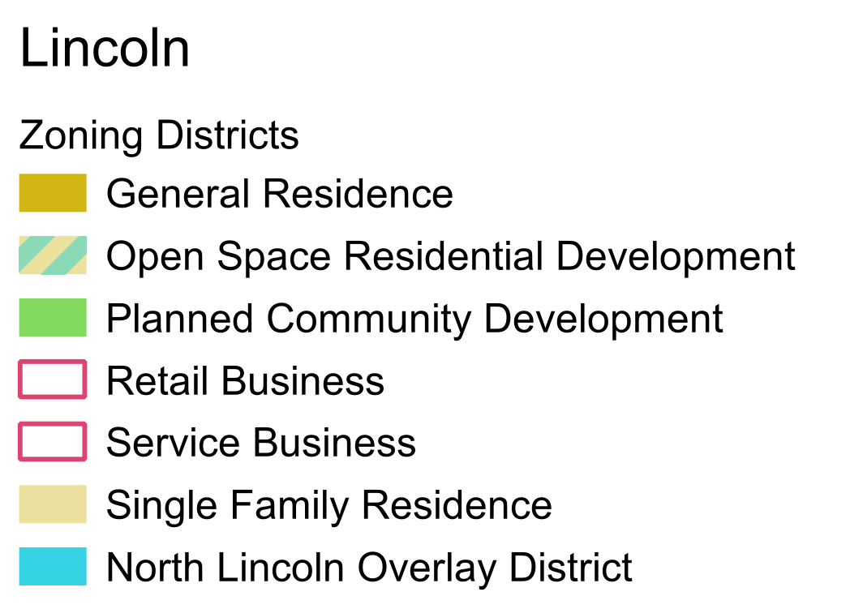
Existing Zoning Districts

Slide 10
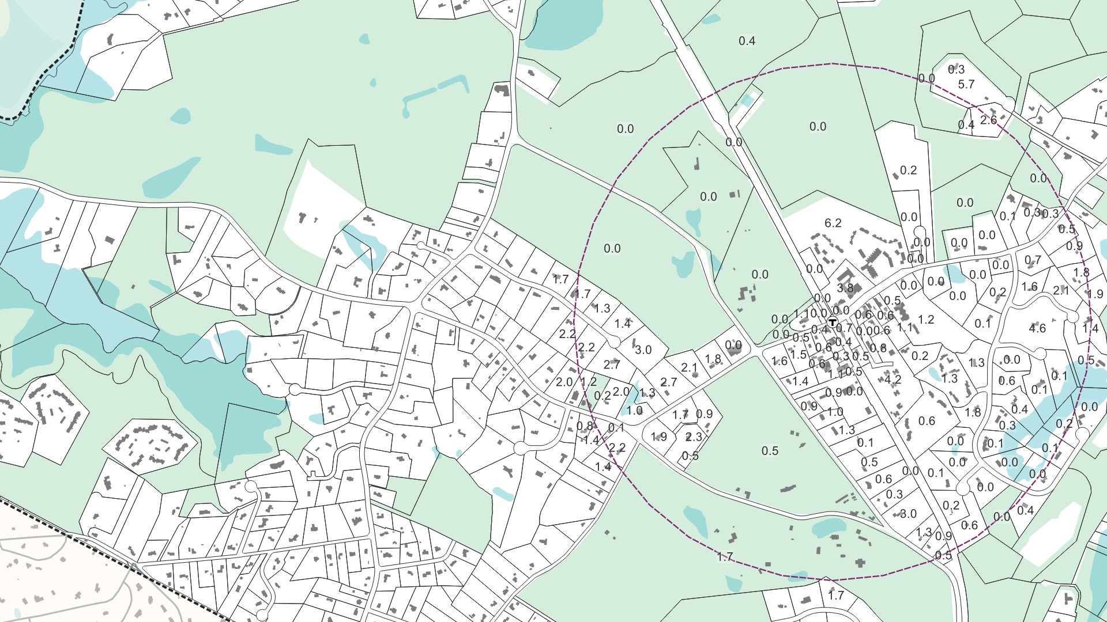
Key Calculations
Calculating developable station area and gross density

Slide 11
Developable Station Area
Calculate area of parcel
Subtract area of land deemed “excluded” by statute (publicly-owned land, surface water bodies, wetland resource areas, with buffer zone equivalent to setback required by Title V of the state environmental code, protected open space/recreational land that is protected in perpetuity, public and private rights-of-way, privately-owned land on which development is prohibited to protect private or public water supplies, including, but not limited to, Zone I wellhead protection areas and Zone A surface water supply protection areas, privately-owned land used for educational or institutional uses)
The state has determined that Lincoln's developable station area is 130 acres.
Note: This is an example for illustrative purposes only. Unit counts and district acreages are estimates and subject to change.
Notes:
“Developable land” means land on which multi-family housing can be permitted and constructed. For purposes of these guidelines, developable land consists of: (i) all privately owned land except lots or portions of lots that meet the definition of excluded land, and (ii) developable public land.
“Developable public land” means any publicly-owned land that (i) is used by a local housing authority; (ii) has been identified as a site for housing development in a housing production plan approved by DHCD; or (iii) has been designated by the public owner for disposition and redevelopment. Other publicly-owned land may qualify as developable public land if DHCD determines, at the request of an MBTA community and after consultation with the public owner, that such land is the location of obsolete structures or uses, or otherwise is suitable for conversion to multi-family housing, and will be converted to or made available for multi-family housing within a reasonable period of time.
“Excluded land” means land areas on which it is not possible or practical to construct multifamily housing. For purposes of these guidelines, excluded land is defined by reference to the ownership, use codes, use restrictions, and hydrological characteristics in MassGIS and consists of the following: 1. All publicly-owned land, except for lots or portions of lots determined to be developable public land. 2. All rivers, streams, lakes, ponds and other surface waterbodies. 3. All wetland resource areas, together with a buffer zone around wetlands and waterbodies equivalent to the minimum setback required by title 5 of the state environmental code. 4. Protected open space and recreational land that is legally protected in perpetuity (for example, land owned by a local land trust or subject to a conservation restriction), or that is likely to remain undeveloped due to functional or traditional use (for example, cemeteries). 5. All public rights-of-way and private rights-of-way. 6. Privately-owned land on which development is prohibited to protect private or public water supplies, including, but not limited to, Zone I wellhead protection areas and Zone A surface water supply protection areas. 7. Privately-owned land used for educational or institutional uses such as a hospital, prison, electric, water, wastewater or other utility, museum, or private school, college or university.

Slide 12

30-acre zone: Wetlands calculation
30-acre zone
10 acres of developable land: Must be zoned for 15 units/acre
10 acres of wetlands:
Wetlands are NOT included in the density calculation
10 acres of developable land: Must be zoned for 15 units/acre
This 30-acre zone would need to be zoned to allow up to 300 units:
30 acres – 10 acres of wetlands = 20 developable acres
20 acres x 15 unit/acre – 300 units
In this example, it would be helpful to include the wetlands because it would make the buildable areas “contiguous.”

Slide 13

30-acre zone: Conservation land calculation
30-acre zone
10 acres of developable land: Must be zoned for ~23 units/acre
10 acres of
conservation land:
Conservation land IS included in the density calculation for this zone.
10 acres of developable land: Must be zoned for ~23 units/acre
This 30-acre zone would need to be zoned to allow up to 450 units:
Only 20 acres able to be developed, but density would need to make up for the land in conservation.
30 acres x 15 units/acre = 450 units
In this example, it would NOT be helpful to include the conservation land. You would need to account for 15 units/acre on the conservation land even though you cannot build on it. Therefore higher density.

Slide 14
Density Examples
Battle Road Farm
The Commons
120 units
24 acres
5 acres are in conservation
Density = 5 u/a
308 units
31.2 acres
5.1 acres are in conservation
Density minus conservation land = 12 u/a
Oriole Landing
60 units
6 acres
0 acres are in conservation
Density = 10 u/a
Height = approx. 30’
Height = 52.5’
Height = 40’
Minuteman Commons
32 units
3.65 acres
0 acres are in conservation
Density = 9 u/a
Height = 45’
Density = 10 u/a
Density minus conservation land = 6.3 u/a

Slide 15
Density Examples
Lincoln Woods
Farrar Pond
125units
20 acres
13 acres are wetlands
Density = 6.3 u/a
80 units
18 acres
Density = 4.4 u/a
Ryan Estates
24 units
8 acres
6.7 acres wetlands
Density = 3 u/a
Height = 18’
Height = 26’
Height = 45’
Density without wetlands = 17.9 u/a
Density minus wetlands = 18.5 u/a single building

Slide 16
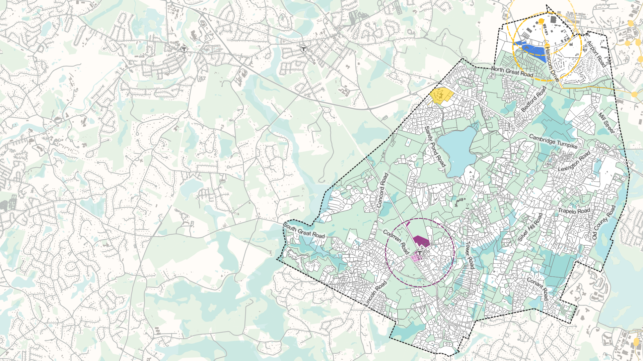
Preview
Subdistricts discussed by Working Group
BRF/Lincoln North/MM
Commons/Oriole Landing
Village Center District
VC – Lincoln Woods Subdistrict
VC – B-2 Subdistrict
VC – Codman Corner

Slide 17
Village Center Subdistricts
Lincoln Woods Subdistrict
B-2 Subdistrict
Codman Corner Subdistrict

Slide 18
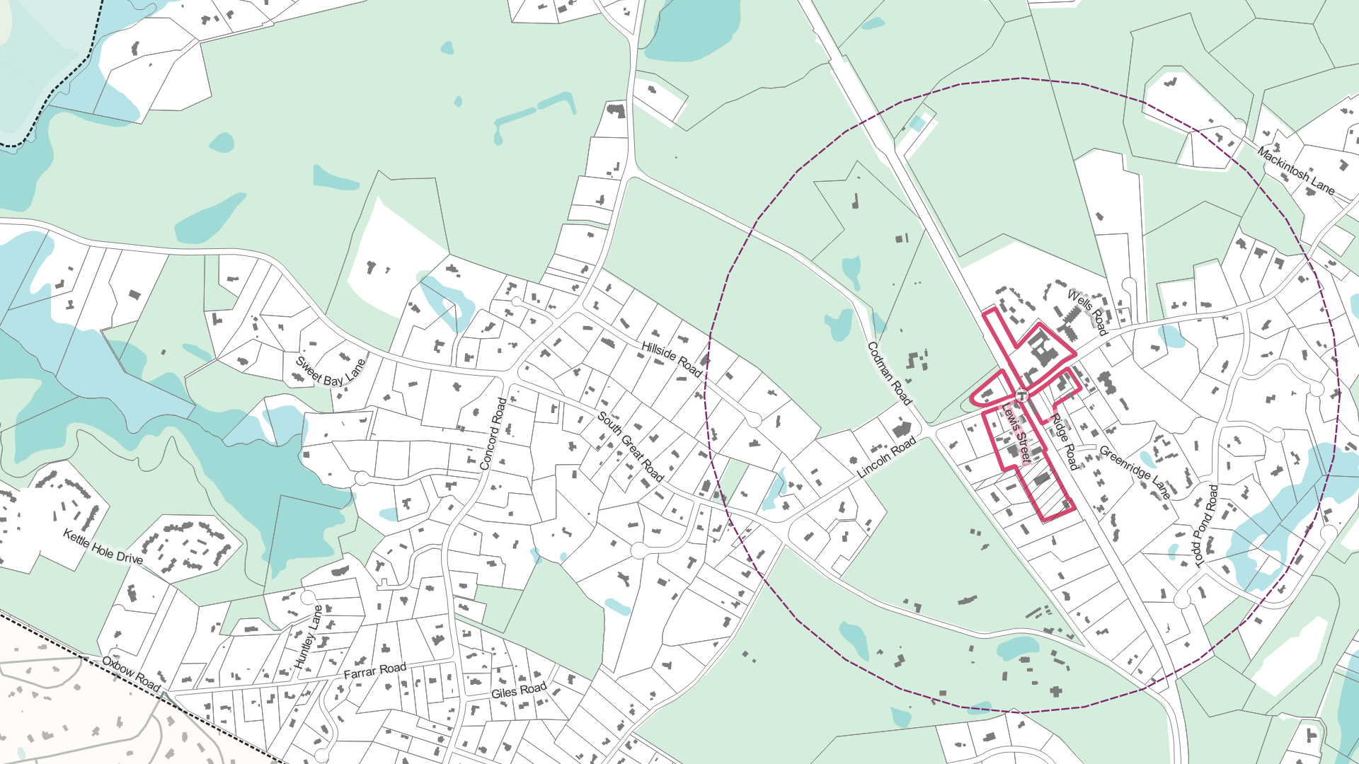
Village Center Context & Constraints
Existing B-1 District
Existing B-2 District
Existing DPW Site
½ Mile Station Area
Note: This is an example for illustrative purposes only. Unit counts and district acreages are estimates and subject to change.
Notes:
Note that other communities we are working with are avoiding including their commercial districts as part of this process because of the risk of losing ground floor commercial space

Slide 19
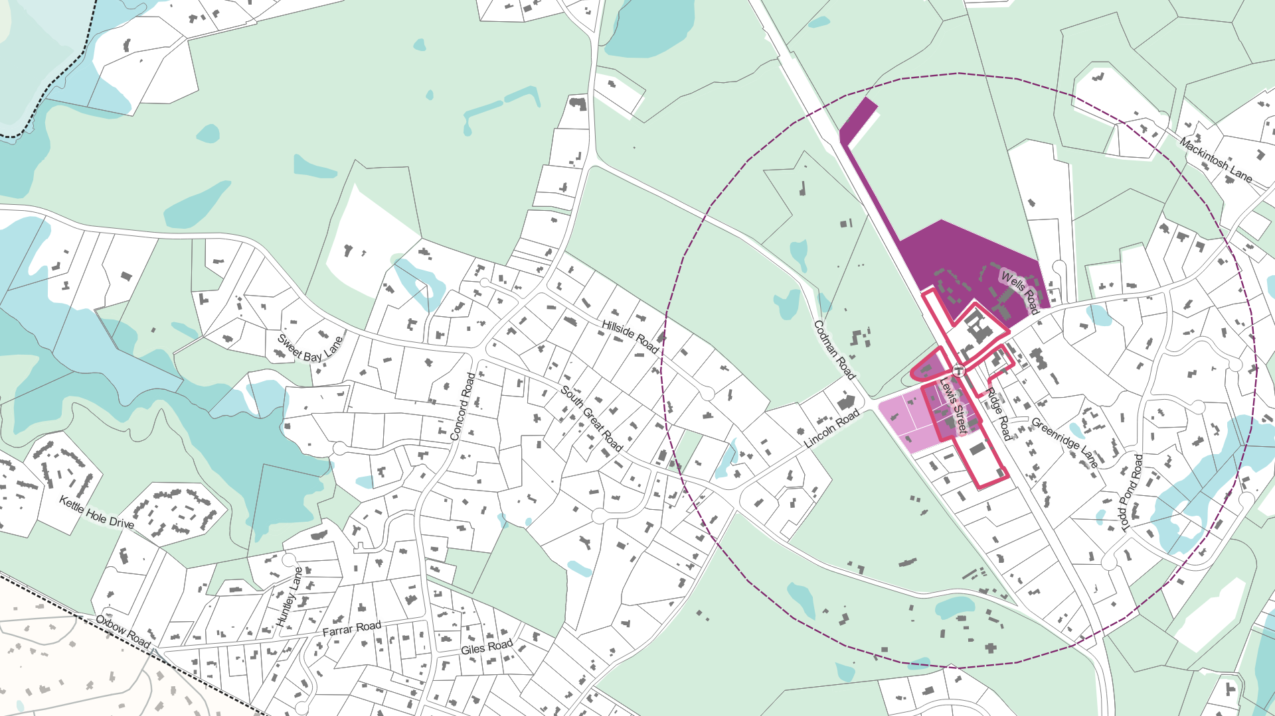
Village Center — Subdistricts
VC – Lincoln Woods Subdistrict
Maintain Existing B-1 District
VC – B-2 Subdistrict
Existing B-2 District
VC – Codman Corner Subdistrict
Existing DPW Site
½ Mile Station Area
Note: This is an example for illustrative purposes only. Unit counts and district acreages are estimates and subject to change.

Slide 20
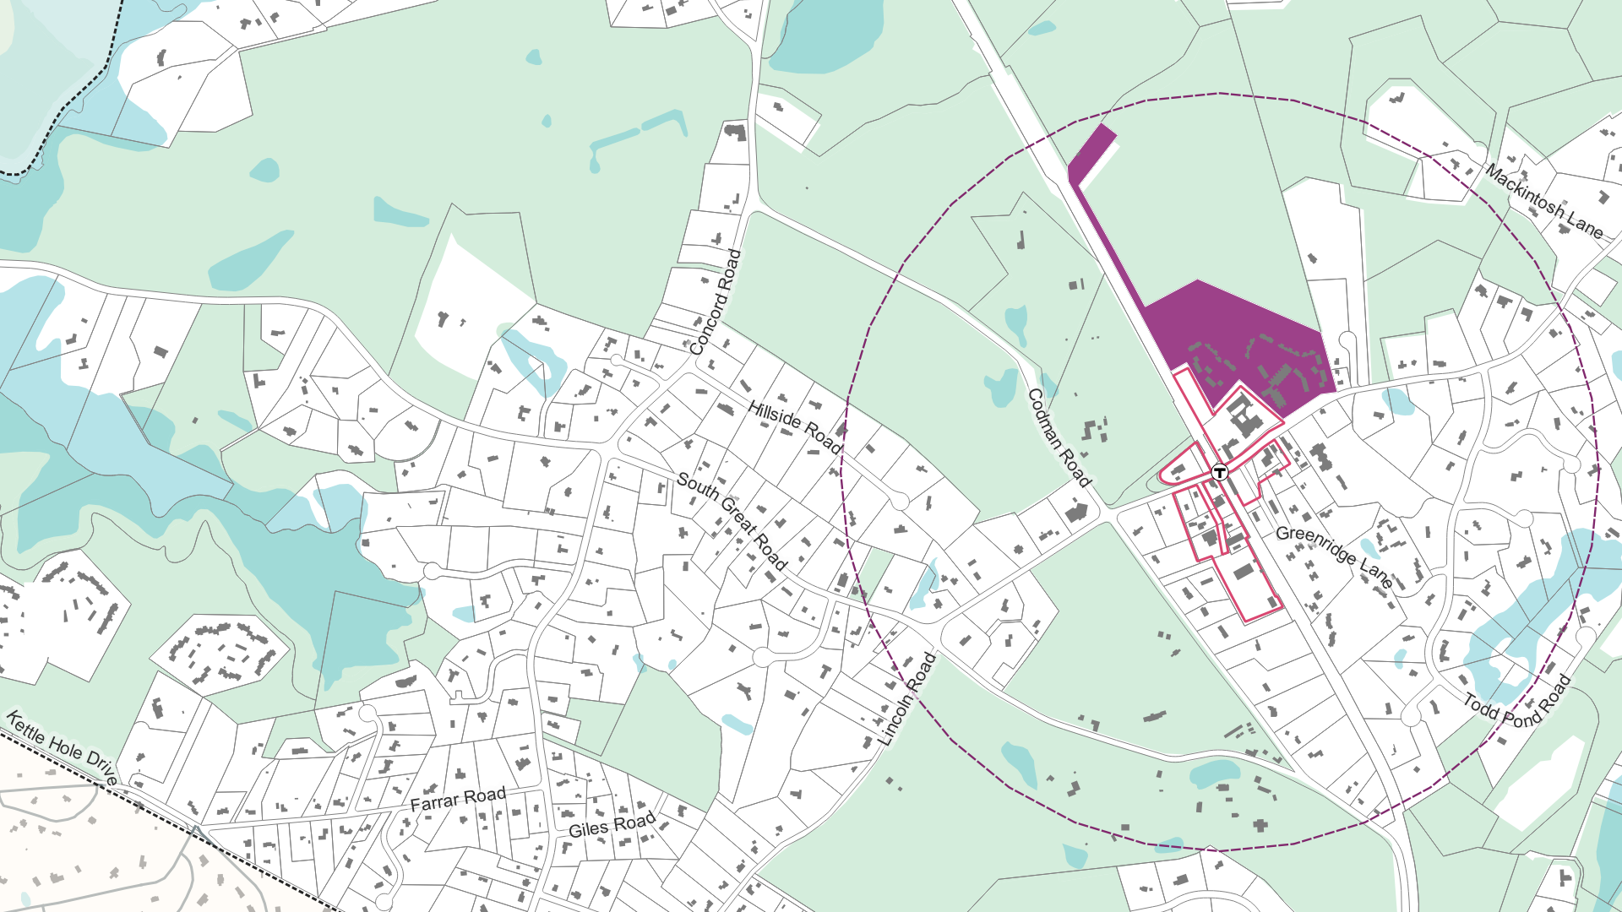
Village Center – Lincoln Woods Subdistrict
VC – Lincoln Woods
Draft Zoning Standards:
No min. lot size
Max Height 36’ = 3.5 stories
Setbacks:
Front: 25’
Sides: 25’
Rear: 25’
Min. parking space per unit: 1
Maintain Existing B-1 District
Existing B-2 District
Existing DPW Site
½ Mile Station Area
Note: This is an example for illustrative purposes only. Unit counts and district acreages are estimates and subject to change.

Slide 21
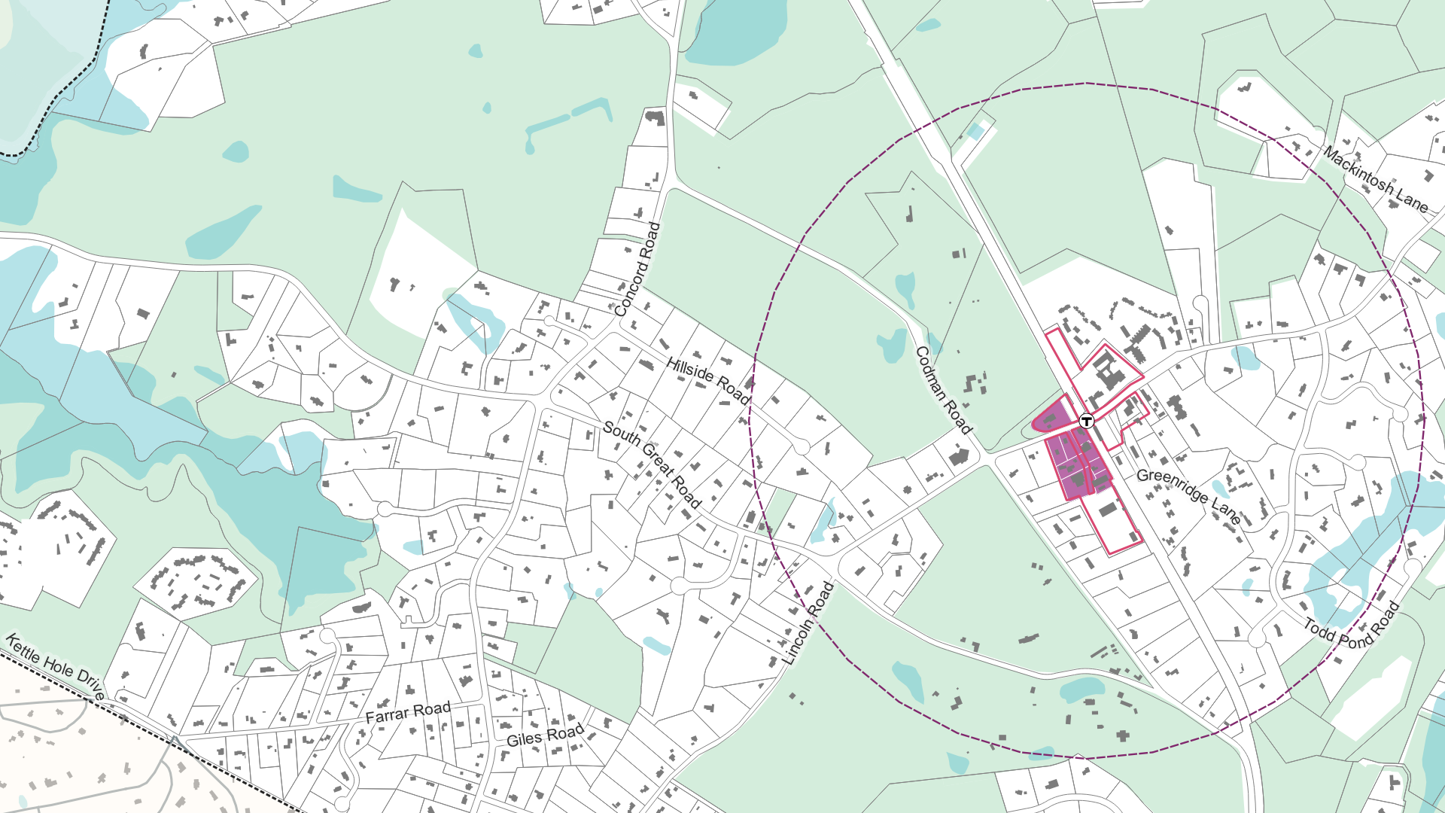
Village Center – B-2 Subdistrict
Maintain Existing B-1 District
VC – B-2
Draft Zoning Standards:
No min. lot size
Max Height 36’ = 3.5 stories
Setbacks:
Front: 15’
Sides: 15’
Rear: 25’
Min. parking space per unit: 1
Max. Units per Acre: 15
Existing B-2 District
Existing DPW Site
½ Mile Station Area
Note: This is an example for illustrative purposes only. Unit counts and district acreages are estimates and subject to change.

Slide 22
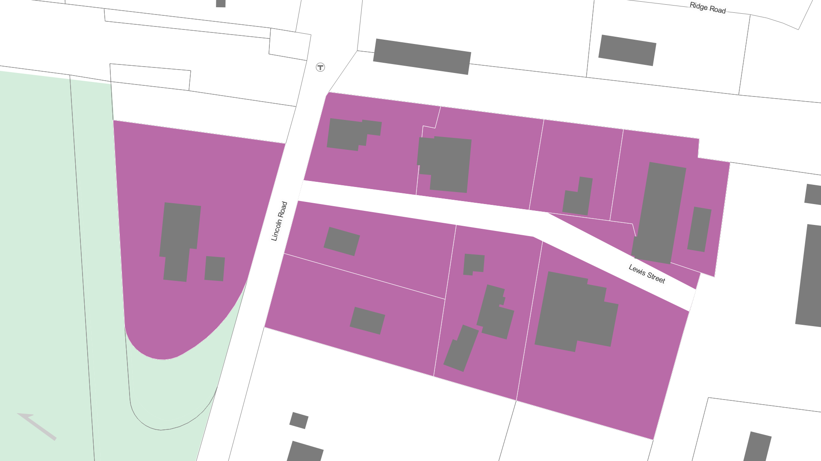
VC – B-2 Subdistrict Existing Setbacks
13’
46’
88’
11’
28’
14’
47’
122’
18’
107’

Slide 23
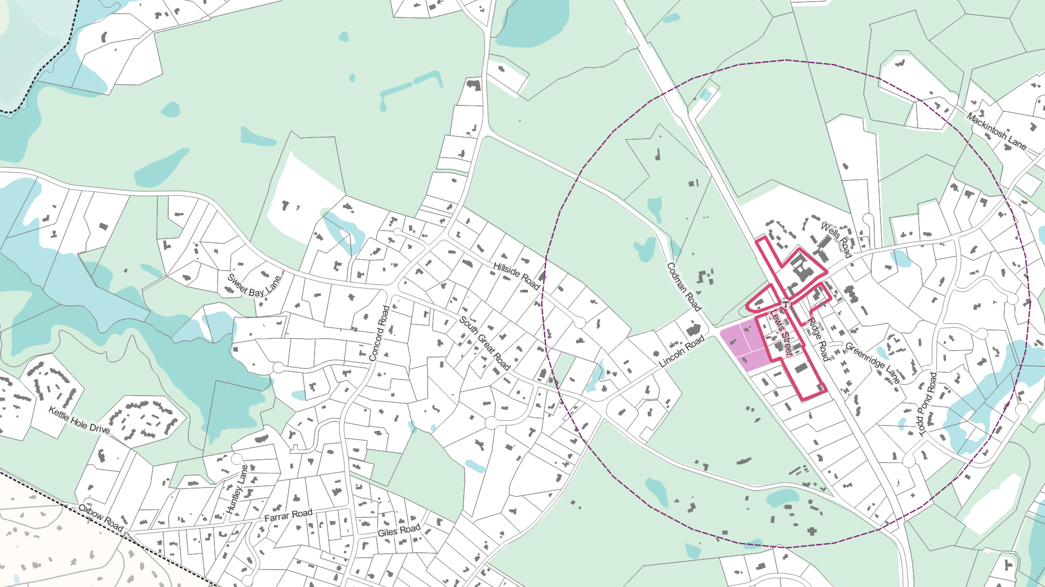
Village Center – Codman Corner Subdistrict
Maintain Existing B-1 District
VC – Codman Corner
Draft Zoning Standards:
No min. lot size
Max Height 36’ = 3.5 stories
Setbacks:
Front: 50’
Sides: 30’
Rear: 30’
Min. parking space per unit: 1
Max. units per acre: 15
Existing B-2 District
Existing DPW Site
½ Mile Station Area
Note: This is an example for illustrative purposes only. Unit counts and district acreages are estimates and subject to change.
Notes:
Mention that the DPW parcel could be included in the VC- B-2 subdistrict as an additional option

Slide 24
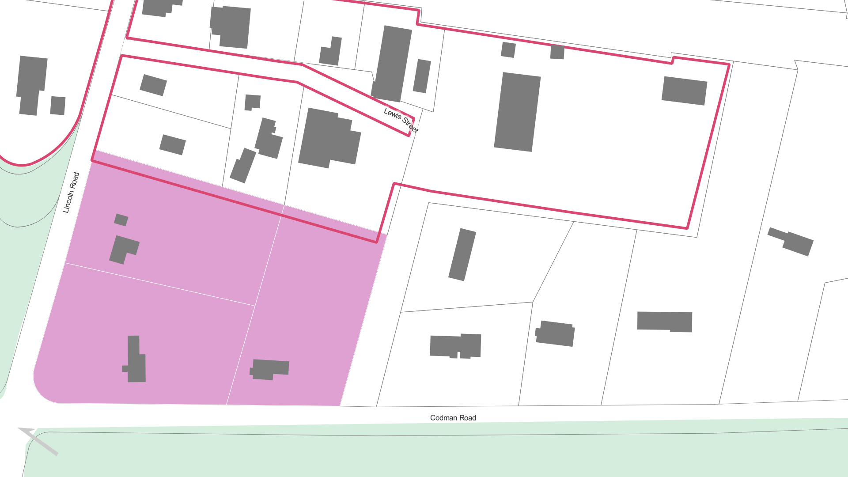
Codman Corner Existing Setbacks
131’
75’
222’
178’
135’
93’
30’
75’
61’
80’
72’
143’
152’
107’
38’
43’
82’
103’
126’

Slide 25
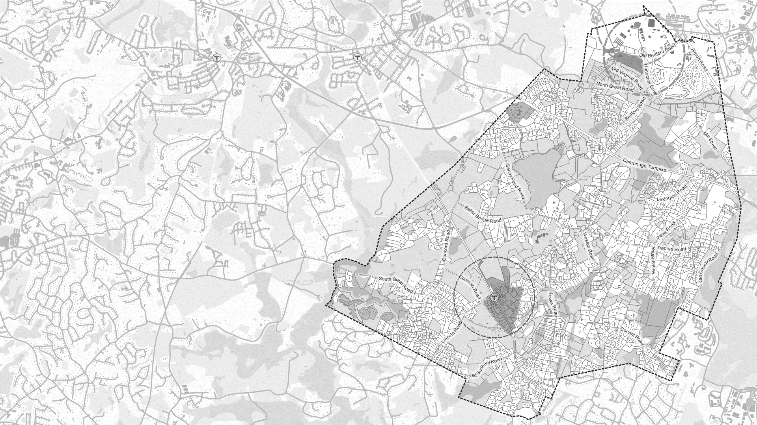
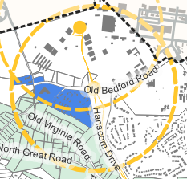
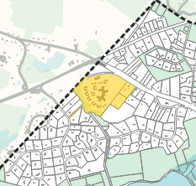
Other Subdistricts
Battle Road Farm/Lincoln North/MM Subdistrict
Commons/Oriole Landing Subdistrict

Slide 26
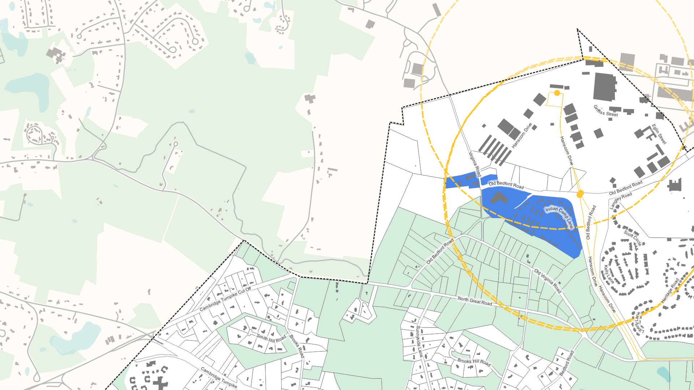
BRF/Lincoln North/MM
BRF/Lincoln North/MM
Draft Zoning Standards:
No min. lot size
Max Height 36’ = 3.5 stories
Setbacks:
Front: 25’
Sides: 25’
Rear: 30’
Min. parking space per unit: 1
Max. units per acre: 15
½ Mile Bus Stop Area
Note: This is an example for illustrative purposes only. Unit counts and district acreages are estimates and subject to change.
Notes:
Mention that this area complies with the spirit of the legislation - has transit access
MM is Minuteman

Slide 27
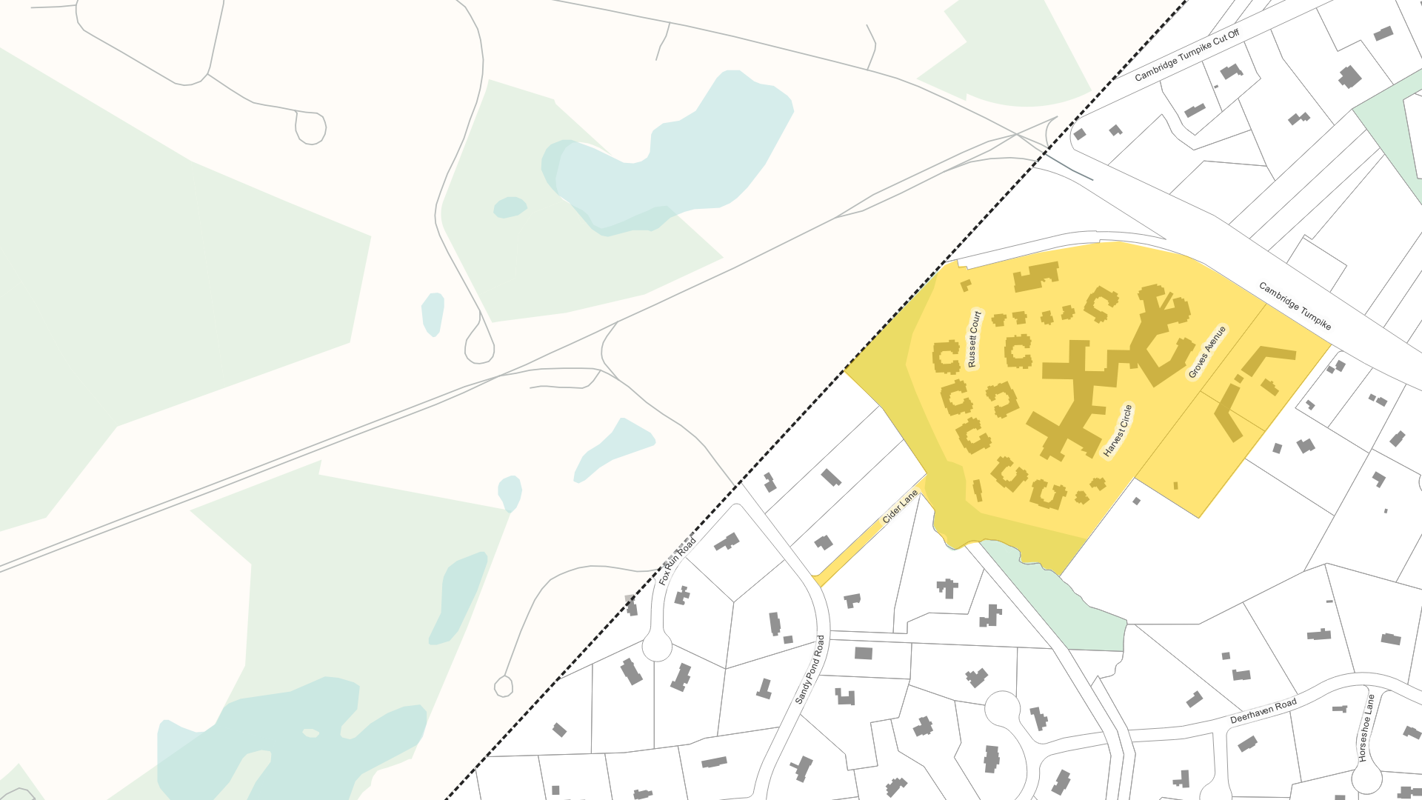
Commons/Oriole Landing
Commons/Oriole Landing
Draft Zoning Standards:
No min. lot size
Max Height 36’ = 3.5 stories
Setbacks:
Front: 25’
Sides: 25
Rear: 25’
Min. parking space per unit: 1
Max. units per acre: 15
Note: This subdistrict is not located in a transit-accessible area.
Note: This is an example for illustrative purposes only. Unit counts and district acreages are estimates and subject to change.
Notes:
Mention that this is a candidate subdistrict, but it is not within a transit walkshed

Slide 28
Townwide Summary
Potential Subdistrict Locations & Modeled Multifamily Unit Capacity
BRF/Lincoln North/MM: 559 units
Commons/Oriole Landing: 551 units
VC - Lincoln Woods: 185 units
VC - B-2: 82 units
VC - Codman Corner: 69 units
Notes:
Should we run some scenarios that reduce the unit count in Codman St. district? Seeing 570 units there vs. 560 in BRF might raise eyebrows

Slide 29
Townwide Summary
Zoning Standards & Model Outputs including all candidate subdistricts
Draft District Name | Max. Height | Setbacks | Min. Parking Spaces per Unit | Max. Units per Acre | Modeled Multifamily Unit Capacity | District Acreage | Subdistrict Density Denominator* | Modeled Gross Subdistrict Density**
VC – Lincoln Woods | Max Height 36’ = 3.5 stories | Front: 25’ Sides: 25’ Rear: 25’ | 1 | - | 185 | 20.1 acres | 7 acres | 26.5 Units/Acre = 185 units / 7 acres
VC – B-2 | Max Height 36’ = 3.5 stories | Front: 15’ Sides: 15’ Rear: 25’ | 1 | 15 | 82 | 5.7 acres | 5.7 acres | 14.4 Units/Acre = 82 units / 5.7 acres
VC – Codman Corner | Max Height 36’ = 3.5 stories | Front: 50’ Sides: 30’ Rear: 30’ | 1 | 15 | 69 | 4.6 acres | 4.6 acres | 15.1 Units/Acre = 69 units / 4.6 acres
BRF/Lincoln North/MM | Max Height 36’ = 3.5 stories | Front: 25’ Sides: 25’ Rear: 30’ | 1 | 15 | 559 | 39 acres | 34.2 acres | 16.4 Units/Acre = 559 units / 34.2 acres
Commons/ Oriole | Max Height 36’ = 3.5 stories | Front: 25’ Sides: 25’ Rear:25’ | 1 | 15 | 551 | 37.1 acres | 37.1 acres | 14.9 Units/Acre = 551 units / 37.1 acres
TOTAL | - | - | - | - | 1,446 units | 106.5 acres | 88.5 acres | 16.3 Units/Acre = 1,446 units / 88.5 acres
* “District Density Denominator” is the district size MINUS any areas containing: wetlands, water bodies, Title V setbacks, Surface Water Protection Zone A, and Wellhead Protection Zone 1.
** District Density is calculated as Modeled Unit Capacity / District Density Denominator

Slide 30
Townwide Summary
VC- Lincoln Woods
BRF/Lincoln North/MM
VC- B-2
Commons/Oriole Landing
Compliance Check including all candidate subdistricts
VC - Codman Corner
Compliance Requirement | Modeled Result | Compliant?
Modeled Unit Capacity ≥ 635 units | 1,446 units | Yes.
District Land Area ≥ 42 acres | 106.5 acres | Yes.
Gross Density ≥ 15 units/acre | 16.3 Units/Acre | Yes.
% Land Area in Station Area ≥ 20% | VC-Lincoln Woods + VC-B-2 + VC-Codman Corner= 20 acres + 6 acres + 4.6 acres = 29% | Yes.
% Modeled Unit Capacity in Station Area ≥ 20% | VC-Lincoln Woods + VC-B-2 + VC-Codman Corner = 190 units + 80 units + 69 units = 23% | Yes.
One contiguous district area must contain ≥ 50% of total district land area | BRF/Lincoln North/MM = 39 acres = 37% Commons/Oriole Landing = 37 acres = 35% VC-B-2 + VC-Codman Corner = 10.3 acres = 10% VC Lincoln Woods = 20 acres = 19% | No.

Slide 31
Townwide Summary
VC- Lincoln Woods
BRF/Lincoln North/MM
VC- B-2
Commons/Oriole Landing
Compliance Check excluding Battle Road Farm/Lincoln North
VC - Codman Corner
Compliance Requirement | Modeled Result | Compliant?
Modeled Unit Capacity ≥ 635 units | 887 units | Yes.
District Land Area ≥ 42 acres | 67.5 acres (54.4 acres = Gross Density Denominator) | Yes.
Gross Density ≥ 15 units/acre | 887 units / 54.4 acres = 16.3 Units/Acre | Yes.
% Land Area in Station Area ≥ 20% | VC-Lincoln Woods + VC-B-2 + VC-Codman Corner = 20.1 acres + 5.7 acres + 4.6 acres= 45% | Yes.
% Modeled Unit Capacity in Station Area ≥ 20% | VC-Lincoln Woods + VC-B-2 +VC-Codman Corner = 185 units + 82 units + 69 units = 38% | Yes.
One contiguous district must contain ≥ 50% of total district land area | Commons/Oriole Landing = 37.1 acres = 55% VC B-2 + VC-Codman Corner= 5.7 acres + 4.6 acres= 15.3 % VC Lincoln Woods = 20.1 acres = 29.8% | Yes.

Slide 32
Townwide Summary
VC- Lincoln Woods
BRF/Lincoln North/MM
VC- B-2
Commons/Oriole Landing
Compliance Check excluding Commons/Oriole Landing
VC - Codman Corner
Compliance Requirement | Modeled Result | Compliant?
Modeled Unit Capacity ≥ 635 units | 895 units | Yes.
District Land Area ≥ 42 acres | 64 acres (51.5 acres = Gross Density Denominator) | Yes.
Gross Density ≥ 15 units/acre | 895 units / 51.5 acres = 17.4 Units/Acre | Yes.
% Land Area in Station Area ≥ 20% | VC-Lincoln Woods + VC-B-2 + VC-Codman Corner = 20.1 acres + 5.7 acres + 4.6 acres = 47.5% | Yes.
% Modeled Unit Capacity in Station Area ≥ 20% | VC-Lincoln Woods + VC-B-2 + VC-Codman Corner= 185 units + 82 units + 69 units = 37.5% | Yes.
One contiguous district must contain ≥ 50% of total district land area | BRF/Lincoln North/MM = 39 acres = 60.9% VC-Lincoln Woods = 20.1 acres = 31.4% VC-Codman Corner + VC-B-2 = 4.6 acres + 5.7 acres = 16% | Yes.

Slide 33
Townwide Summary
VC- Lincoln Woods
BRF/Lincoln North/MM
VC- B-2
Commons/Oriole Landing
Compliance Check excluding Commons/Oriole Landing AND
VC-Codman Corner
VC - Codman Corner
Compliance Requirement | Modeled Result | Compliant?
Modeled Unit Capacity ≥ 635 units | 826 units | Yes.
District Land Area ≥ 42 acres | 64.8 acres (46.9 acres = Gross Density Denominator) | Yes.
Gross Density ≥ 15 units/acre | 826 units / 46.9 acres = 17.6 Units/Acre | Yes.
% Land Area in Station Area ≥ 20% | VC-Lincoln Woods + VC-B-2 = 20.1 acres + 5.7 acres = 39.8% | Yes.
% Modeled Unit Capacity in Station Area ≥ 20% | VC-Lincoln Woods + VC-B-2 = 185 units + 82 units = 32.3% | Yes.
One contiguous district must contain ≥ 50% of total district land area | BRF/Lincoln North/MM = 39 acres = 60.2% VC-Lincoln Woods = 20.1 acres = 31% VC-B-2 = 5.7 acres = 8.8% | Yes.
Notes:
The DPW parcel could be moved from the Codman Corner subdistrict to the B-2 subdistrict and we would still meet compliance

Slide 34
Townwide Summary
VC- Lincoln Woods
BRF/Lincoln North/MM
VC- B-2
Commons/Oriole Landing
Compliance Check excluding BRF/Lincoln North/MM & VC-Codman Corner
VC - Codman Corner
Compliance Requirement | Modeled Result | Compliant?
Modeled Unit Capacity ≥ 635 units | 818 units | Yes.
District Land Area ≥ 42 acres | 62.9 acres (49.8 acres = Gross Density Denominator) | Yes.
Gross Density ≥ 15 units/acre | 818 units / 49.8 acres = 16.4 Units/Acre | Yes.
% Land Area in Station Area ≥ 20% | VC-Lincoln Woods + VC-B-2 = 20.1 acres + 5.7 acres = 41% | Yes.
% Modeled Unit Capacity in Station Area ≥ 20% | VC-Lincoln Woods + VC-B-2 = 185 units + 82 units= 32.6% | Yes.
One contiguous district must contain ≥ 50% of total district land area | VC-Lincoln Woods = 20.1 acres = 32% VC-B-2 = 5.7 acres = 9.1% Commons/Oriole Landing = 59% | Yes.

Slide 35
Pathways to Compliance
District Options | Does this set of districts comply as currently drawn and with current proposed zoning? | Modeled Multifamily Unit Capacity | Acreage | Modeled Gross Density | Notes
VC- Lincoln Woods VC - B-2 VC- Codman Corner BRF/Lincoln North/MM Commons/Oriole Landing | No. | 1,446 units | 106.5 acres | 16.3 units/acre | See Slide 30
VC- Lincoln Woods VC - B-2 VC- Codman Corner BRF/Lincoln North/MM Commons/Oriole Landing | Yes. | 887 units | 67.5 acres | 16.3 units/acre | See Slide 31 Dimensional standards can be adjusted to bring modeled unit capacity and modeled density closer to MBTA Communities requirements.
VC- Lincoln Woods VC - B-2 VC- Codman Corner BRF/Lincoln North/MM Commons/Oriole Landing | Yes. | 895 units | 64 acres | 17.4 units/acre | See Slide 32 Dimensional standards can be adjusted to bring modeled unit capacity and modeled density closer to MBTA Communities requirements.
VC- Lincoln Woods VC - B-2 VC- Codman Corner BRF/Lincoln North/MM Commons/Oriole Landing | Yes. | 826 units | 64.8 acres | 17.6 units/acre | See Slide 33 Dimensional standards can be adjusted to bring modeled unit capacity and modeled density closer to MBTA Communities requirements
VC- Lincoln Woods VC - B-2 VC- Codman Corner BRF/Lincoln North/MM Commons/Oriole Landing | Yes. | 818 units | 62.9 acres | 16.4 units/acre | See Slide 34 Dimensional standards can be adjusted to bring modeled unit capacity and modeled density closer to MBTA Communities requirements

Slide 36
HCA & Inclusionary Zoning
HCA does not require an affordability component. The HCA guidelines will allow 10% affordability requirements.
Lincoln has “inclusionary zoning” requiring that 15% of multi-family developments be income-restricted
DHCD requires a third-party feasibility study to prove that any affordability requirement greater than 10% will not prohibit development

Slide 37
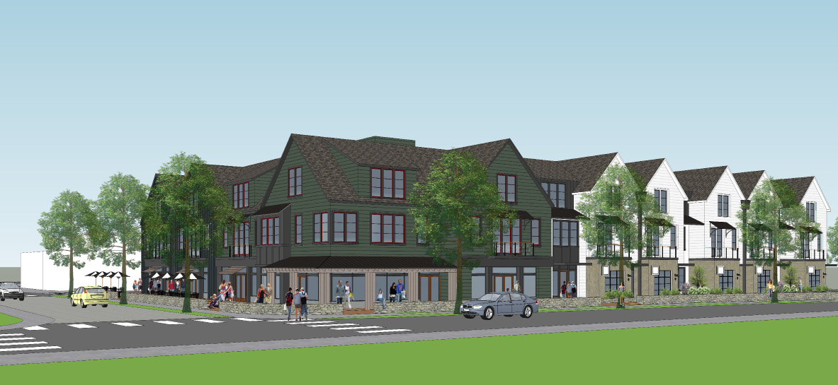
Village Center Mall Subdistrict
The Rural Land Foundation is pursuing a redevelopment plan

Slide 38
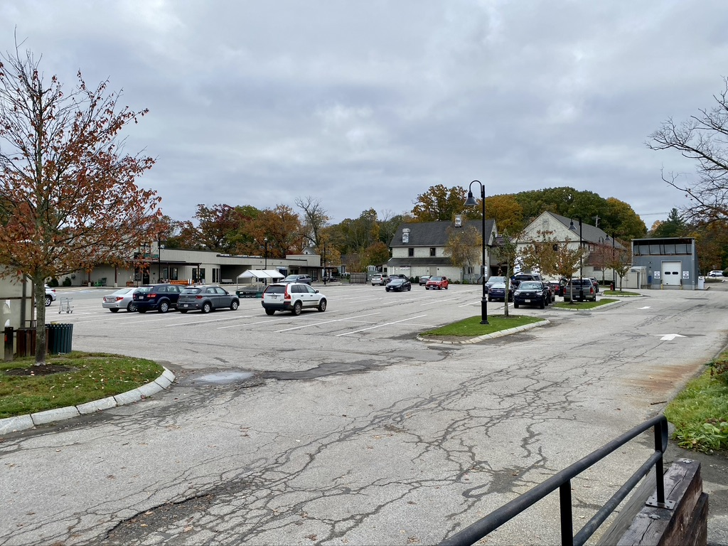
Village Center Mall Subdistrict
The Rural Land Foundation (RLF) is pursuing a redevelopment plan to revitalize The Mall with improved commercial space and multifamily housing
To preserve commercial use, this area cannot be in the HCA district
Instead, Town can rezone The Mall area to allow mixed-use “by right” and simultaneously ensure commercial space is preserved
RLF’s Mall renewal and redevelopment is predicated on such zoning

Slide 39
Why Create the VC-Mall Subdistrict?
HCA is only zoning; no actual housing production is required. Redeveloping The Mall for mixed use would enable Lincoln to respond more quickly to the regional housing crisis with transit-oriented diverse housing supply
Need for improved commercial space, and less of it relative to housing, for economic viability (and vitality!) of The Mall
RLF has a decades-long history of creating conservation-minded diverse housing development in town; this sort of creative land use development is squarely in our mission
Trustees find The Mall to be an increasingly risky and hard-to-justify fiduciary obligation of the RLF; at the same time Trustees recognize that our mission is to serve the town through creative land use development

Slide 40
Why Create the VC-Mall Subdistrict?
With surrounding HCA Zones, and without the ability to have housing by right, the relative valuation of The Mall will decline, making it much harder to create a viable mixed-use project that could be approved at Town Meeting via the current overlay district.
If no zoning change, RLF will most likely need to sell The Mall (true also of redevelopment, but with proposed zoning change we would be able to condition the parameters of the sale to the Town’s advantage)

Slide 41
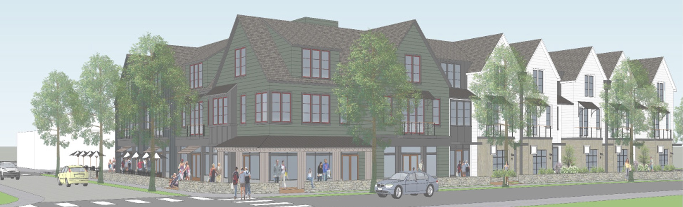
Redeveloping the Mall in the Village Center
RLF is working with a developer known to and trusted by the Town: CIVICO
Phased redevelopment to accommodate anchor and other tenants
RLF and CIVICO would still work with the Town citizenry and leadership to develop a project in keeping with the Town’s ethos and values
RLF does not have the capital to do a Mall redevelopment without a developer so we would conceptualize the project with and then sell to CIVICO (sale contingent on the agreed-upon design)
Based on current analysis, for financial viability of this Mall redevelopment project, a minimum of 25 units per acre built above the commercial spaces would be needed.
Under the current proposal, the Post Office/restaurant building would not be redeveloped

Slide 42
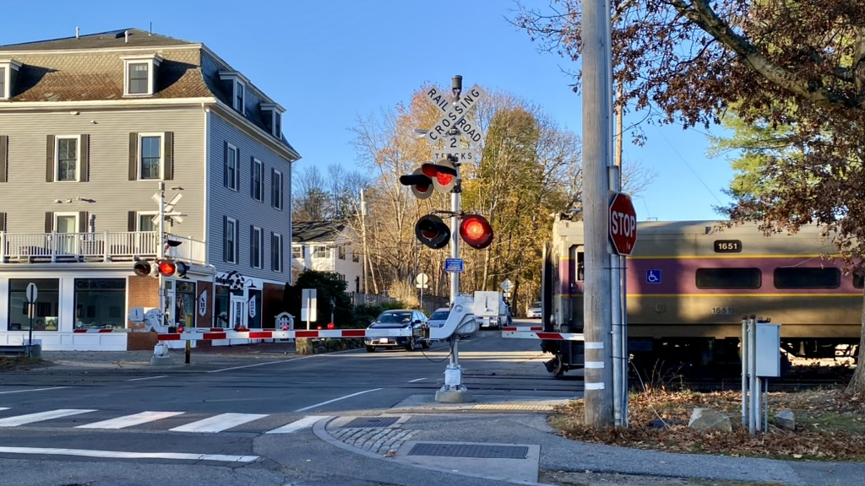
Questions?

Slide 43
Next Steps
ASAP: Inclusionary Zoning Study
June: Public Forums on June 16th and June 20th
Summer: Planning Board drafts zoning proposals
September 30th: State of the Town
December: Submit proposed zoning to DHCD

