Slide 1
Housing Choice Legislation
January 31, 2022

Slide 2
Housing Choice Legislation for MBTA Communities
Enacted as part of the economic development bill in January 2021, new Section 3A of M.G.L. c. 40A (the Zoning Act) requires that an MBTA community shall have at least one zoning district of reasonable size in which multi-family housing is permitted as of right and meets other criteria set forth in the statute:
Minimum gross density of 15 units per acre
Not more than ½ miles from a commuter rail station, subway station, ferry terminal or bus station, if applicable.
No age restrictions
Suitable for families with children.

Slide 3
What is an MBTA Community?
“MBTA community” is defined by reference to M.G.L. c. 161A, sec. 1:
one of the “14 cities and towns” that initially hosted MBTA service; ​
one of the “51 cities and towns” that also host MBTA service but joined later; ​Lincoln is listed as one of these 51
other “served communities” that abut a city or town that hosts MBTA service; or​
a municipality that has been added to the MBTA under G.L. c. 161A, sec. 6 any special law relative to the area constituting the authority.
In total, 175 MBTA communities are subject to the new requirements of Section 3A of the Zoning Act.

Slide 4
What are the General Principles of Compliance?
DHCD is tasked with providing guidance on the legislation.
1. What it means to permit multi-family housing by right
2. How to determine if a multi-family district is “of reasonable size”
3. How to determine gross density of 15 units per acre, subject to wetlands and title V
4. The meaning of “such multi-family housing shall be without age restrictions and shall be suitable for families with children”
5. Parameters of choosing the location of the multi-family district.

Slide 5
What is Lincoln’s MBTA Community Category?
Categories: Rapid Transit; Bus Service; Commuter Rail; Adjacent Community
Current Regulations categorize Lincoln as a “Bus Service Community”
Any community with a bus stop – The 77 bus stops at Hanscom
Lincoln can try for reclassification as a Commuter Rail community.
Even if a town is classified as an adjacent community (within .5 miles of a transit station in another community), it is still subject to the law.

Slide 6
What is “As of Right”?
Construction and occupancy of multi-family housing is allowed without discretionary permit of approval ie. No Special Permits.
Site Plan Approval is allowed.
May regulate vehicular access and circulation, architecture and design, screening of adjacent properties.
Site Plan Review may not impose conditions that make it infeasible or impractical to proceed.

Slide 7
How Do We Determine a District of Reasonable Size?
Land Area: must be at least 50 acres of land-or approximately one-tenth of the land area within .5 miles of a transit station.
An overlay district is ok if at least one portion includes at least 25 contiguous acres and no portion of the district is less than 5 acres.
Unit Capacity: Is a percentage of existing housing units based on category: Rapid Transit – 25%; Bus Service Community – 20%; Commuter Rail – 15%; and Adjacent Community – 10%
Based on % of 2020 Federal Census – Lincoln is 2771 (includes Hanscom) 20%=554 units, 15%=415
Without Hanscom approx. 2400 – 20%=480, 15%=360
Minimum Capacity regardless of Housing Units is 750 units.
Minimum is 15 units/acre on 50 acres = 750 units.

Slide 8
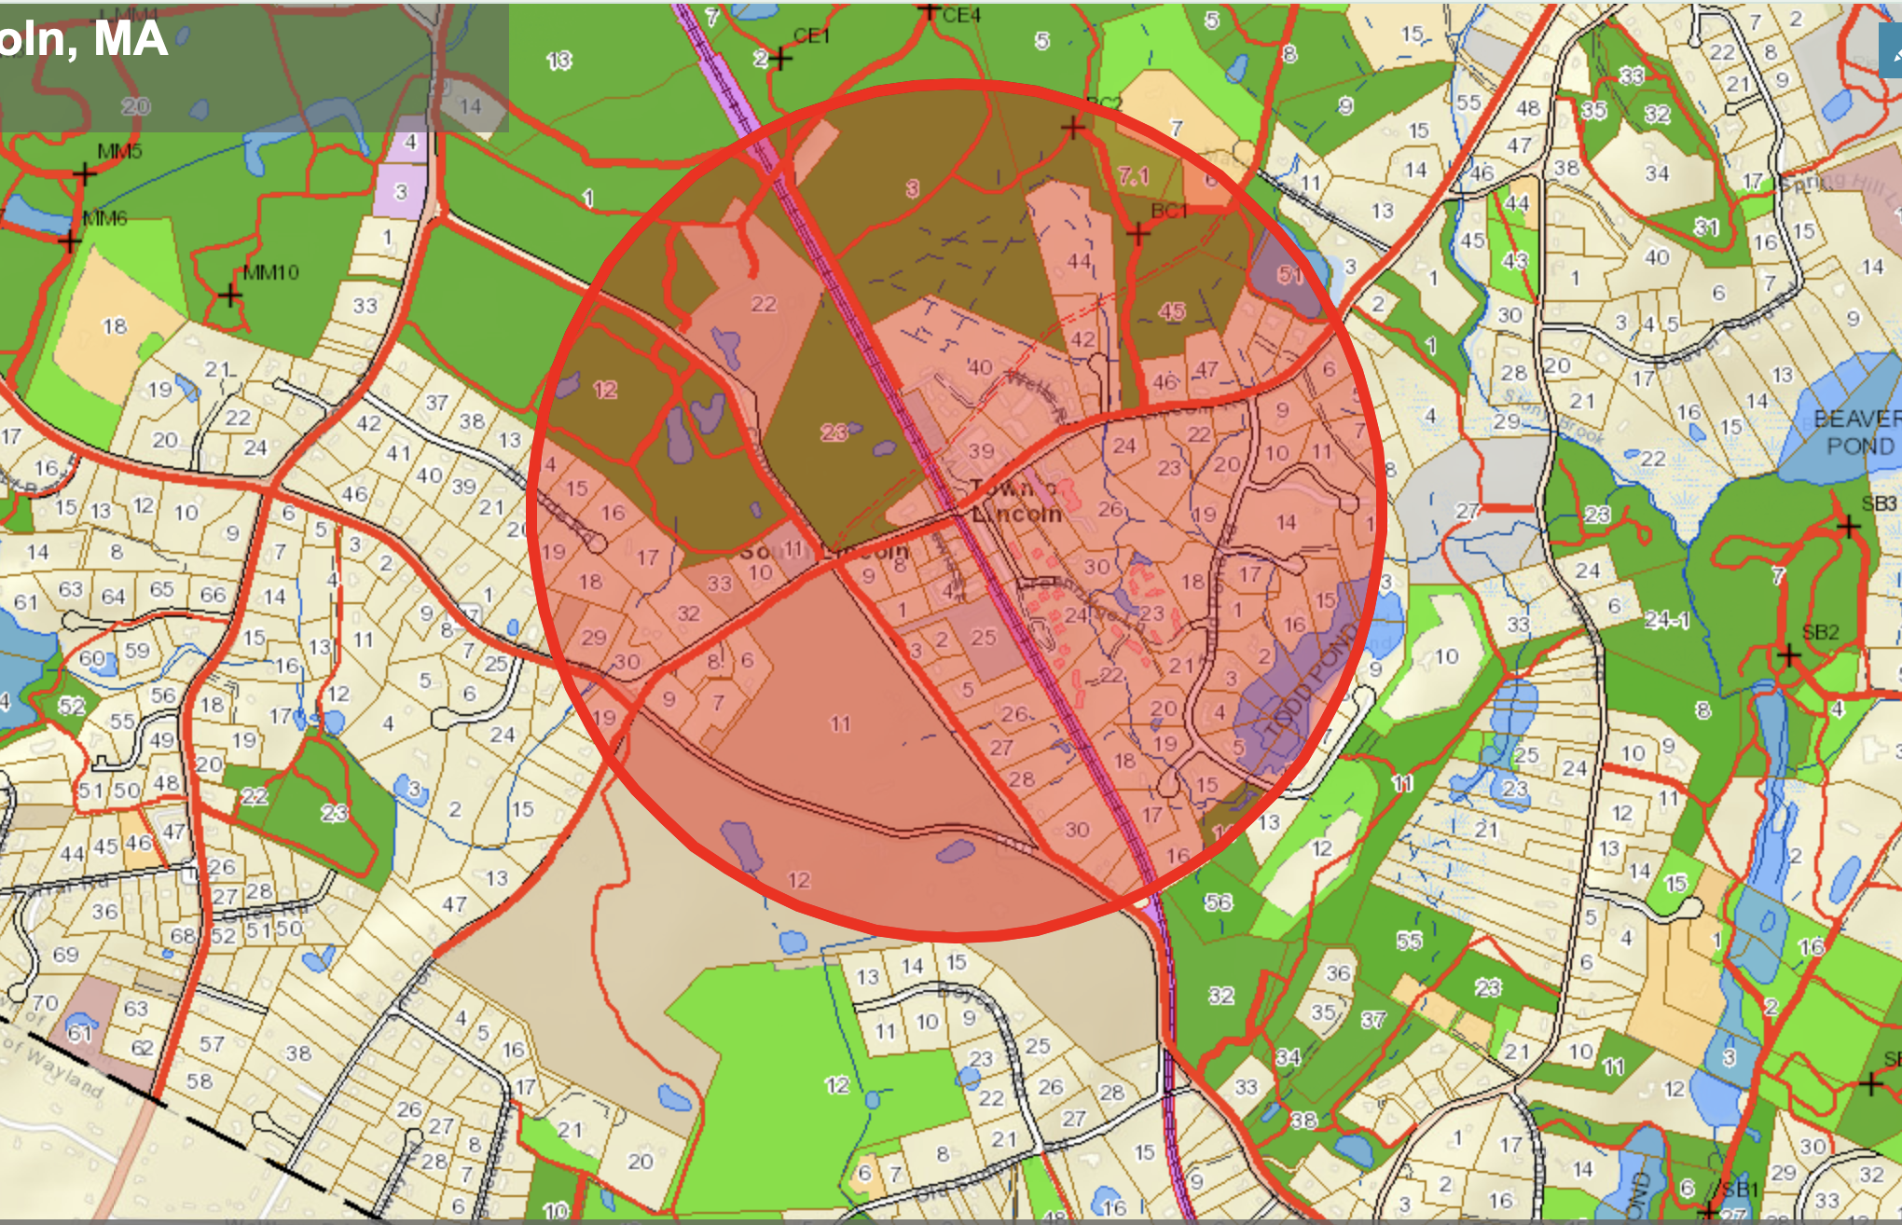

Slide 9
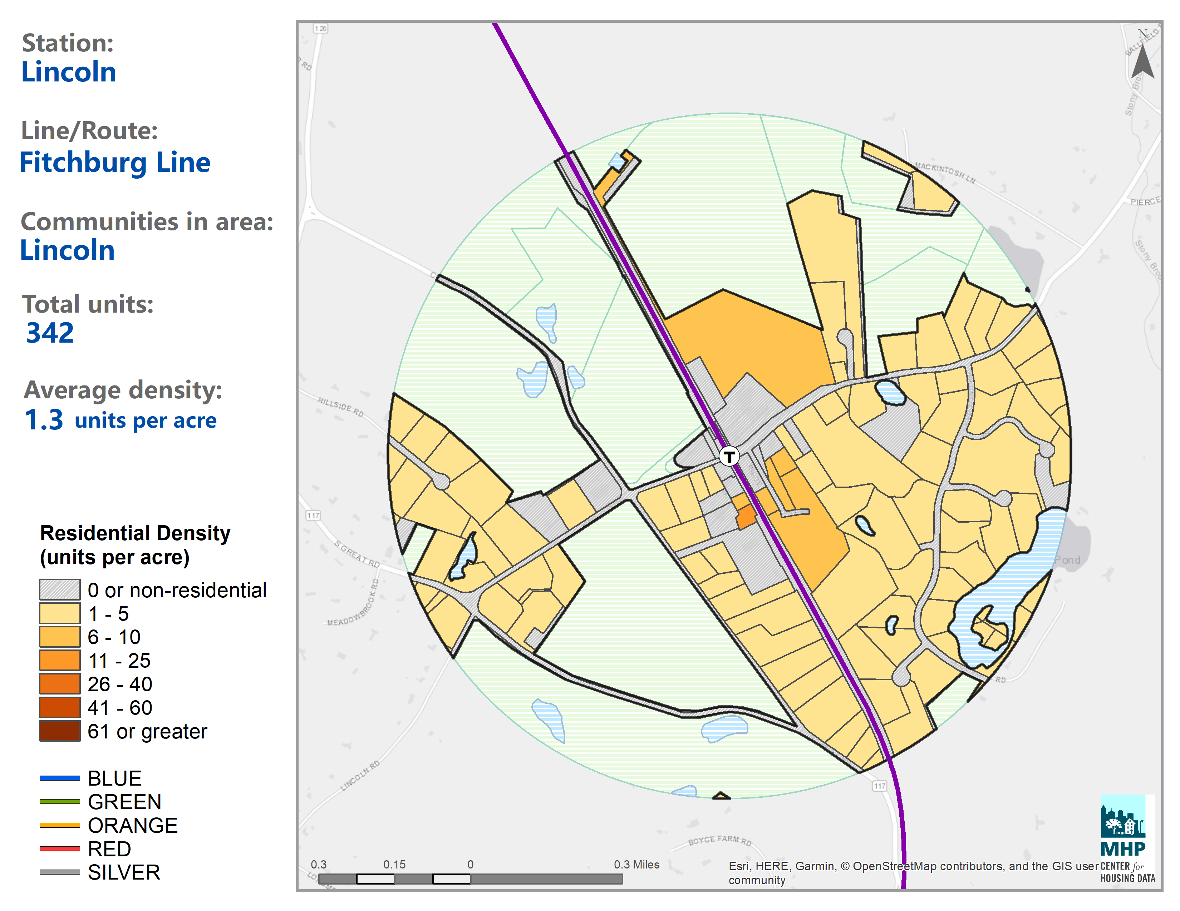

Slide 10
How Many Units are Required?
How is a City or Town Categorized?
A Bus Service Community means an MBTA community with a bus station within its borders or within .5 miles of its border, or an MBTA bus stop within its borders, and no subway station or commuter rail station within its border, or within .5 miles of its border.
Lincoln has been categorized as a Bus Service Community even though it has a commuter rail station. There seems to be an inconsistency in definitions contained in DHCD Guidance.
The category does not matter as to the minimum requirements of 50 acres of land and 750-unit capacity.
It does matter as to the timeline of compliance.

Slide 11
How to Determine Minimum Gross Density of 15 Units/Acre?
District-Wide Gross Density: The municipality must show at least 15 existing or potential multi-family units per acre, or a total of 750 existing or potential new multi-family units.
Sub-Districts: A municipality may establish sub-districts with different density requirements and limitation provided the district as a whole meets the requirement.
As further limited by wetlands and Title V: This is a bit murkier and awaiting clarification.

Slide 12
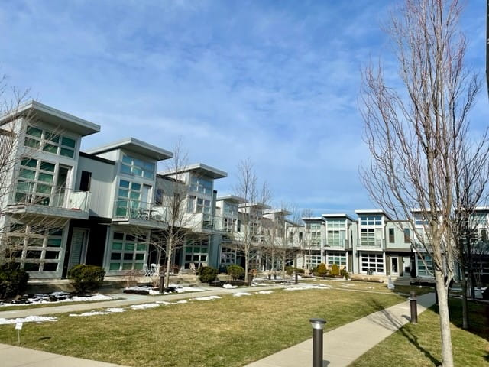
What Does 15 Units/Acre Look Like? This is a photo of 15 townhouses on 1 acre.

Slide 13
How to Determine Suitability for Families with Children?
Zoning will comply if:
1. Units do not have age restrictions
2. There are no limitations on the size of units, the number of bedrooms, the size of bedrooms, or the number of occupants.

Slide 14
Where Must a Municipality Locate its District?
Within .5 miles of a transit station.
Measuring distance from a transit station: May measure from the boundary of any parcel of land owned by the public entity and used for purposes related to the transit station such as an access roadway or parking lot.
Where is Lincoln’s transit station?: Lincoln’s transit station is the commuter rail stop. It is not the bus stop at Hanscom because a bus stop does not qualify as a transit station.

Slide 15
What is the Timeline for Compliance?
1. Must provide DHCD with a proposed action plan and timeline for studies and outreach in order to adopt a multi-family district.
For Bus Service Communities: Must obtain DHCD approval of an action plan by March 31, 2023.
For Commuter Rail Communities: Must obtain DHCD approval of an action plan by July 1, 2023.
2. Must adopt zoning amendment
For Bus Service Communities: December 31. 2023
For Commuter Rail Communities: December 31, 2024
3. Within 90 days after adoption of the zoning amendment, must submit an application to DHCD requesting a determination of full compliance.
3. Within 90 days after adoption of the zoning amendment, must submit an application to DHCD requesting a determination of full compliance.

Slide 16
Are There Penalties for Non-Compliance?
Municipalities who do not timely comply with Section 3A:
Will not be eligible for Massworks or Housing Choice Grants.
Will not be eligible for Local Capital Projects Fund established in section 2EEE of chapter 29.
DHCD may, in its discretion, take non-compliance into consideration when making other discretionary grant awards.
Contained in the Draft Guidelines.

Slide 17
What Are The Grant Programs?
Housing Choice Grants:
Municipality must have a Housing Choice designation. Lincoln designated 2021. Expires 2026.
Designation gives points on other grants.
Capital grant funding
Maximum award is $250,000.
MassWorks:
Largest Capital Grant Funding for infrastructure and capital improvements.
Recent awards to similar communities range from $1+ million to several million.
No minimum or maximum amounts
Lincoln has not historically applied for MassWorks funding.
Capital Projects Fund:
Revenue from casino tax and gaming licensee fees
Historically used for subsidizing housing authorities
Note that Draft Guidelines say DHCD can take into consideration non-compliance on other grants. Lincoln received approx. $570K in 2021

Slide 18
Is There Opportunity for Feedback?
The Department has issued Draft Guidelines for public comment
Feedback is due by March 31, 2022

Slide 19
How Do We Comply for 2022?
By 5:00pm on May 2, 2022:
1. Include a presentation of the Draft Guidelines in a meeting of the Select Board, City Council or Town Council, as applicable;
2. Complete and submit the MBTA Community Information Form, found here: www.mass.gov/forms/mbta-community-information-form; and
3. Submit updated GIS parcel maps to MassGIS if the most recent updated parcel maps were submitted prior to January 1, 2020. DHCD will contact each of the 14 MBTA communities that need to submit updated GIS parcel maps.

