Slide 1


Lincoln’s NPDES MS4 Stormwater Program MS4 Regulatory Updates Board of Selectmen Meeting – April 5, 2021
Comprehensive Environmental Incorporated
Client Focused, Responsive, Quality Service • Experienced, Knowledgeable Technical Staff • Innovative, Cost Effective Designs

Slide 2
NPDES MS4 Permit Background
EPA Clean Water Act (1972)
NPDES = “National Pollutant Discharge Elimination System”
MS4 = “Municipal Separate Storm Sewer System”
What is it really? = regulations on pollutant discharges into waterbodies via the Town’s drainage system
Phase I: regulated communities >100,000 people in 1990
Phase II: MS4 communities >1,000 people in 1999
Unfunded Mandate
Client Focused, Responsive, Quality Service • Experienced, Knowledgeable Technical Staff • Innovative, Cost Effective Designs

Slide 3
MS4 Permit Requirements
Renewal to 2003 Permit Released in April 2016
Now Effective July 1, 2018
To Be Effective July 1, 2017
Delayed 1 Year
6 Minimum Measures
1. Public Education & Outreach
2. Public Involvement & Participation
3. Illicit Discharge Detection & Elimination (IDDE)
4. Construction Site Stormwater Controls/Regulations
5. Post-Construction Site Stormwater Controls/Regulations
6. Good Housekeeping
Client Focused, Responsive, Quality Service • Experienced, Knowledgeable Technical Staff • Innovative, Cost Effective Designs

Slide 4
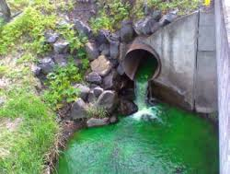
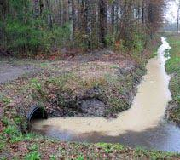
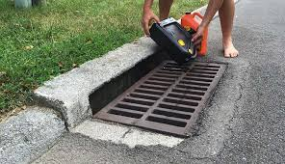
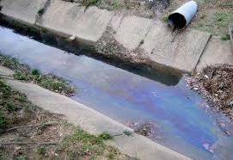
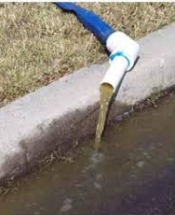
3 Regulatory Mechanisms
#1 Illicit Discharge Detection & Elimination
Prohibit illicit discharges
Investigate suspected ones
Eliminate illicit discharges
Enforcement procedures/actions
Client Focused, Responsive, Quality Service • Experienced, Knowledgeable Technical Staff • Innovative, Cost Effective Designs

Slide 5
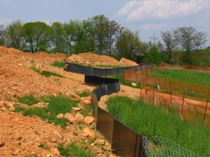
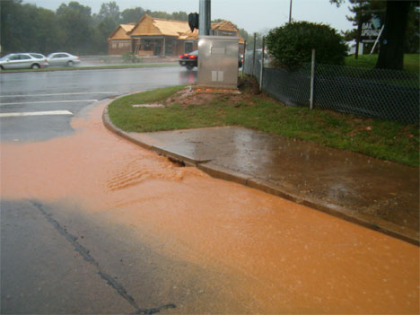
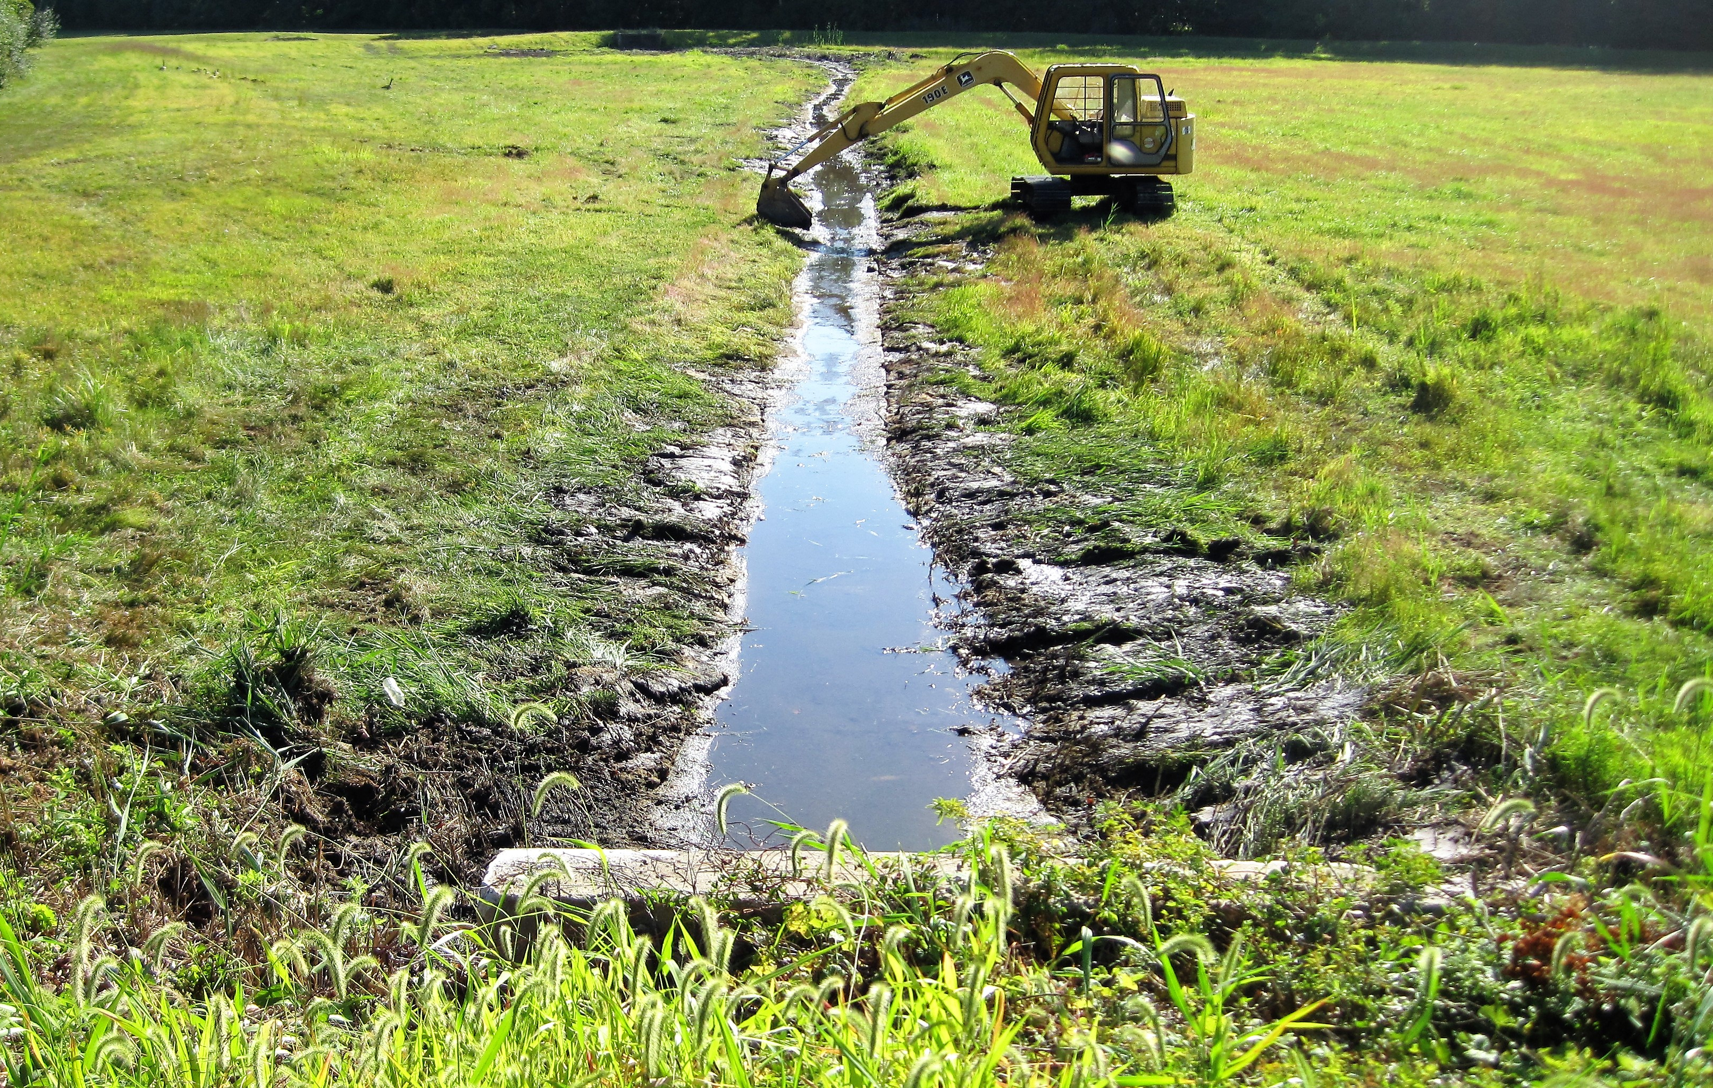
3 Regulatory Mechanisms
Image Credit: https://www.hendersonvillenc.gov/stormwater-management
#2 Require Erosion & Sediment Controls during Construction
Use erosion and sediment controls
Site plan review before construction
Site inspections and by who
Use of LID controls
Image Credit: http://www.middlesexcountynj.gov/Government/Departments/PSH/Pages/MCMosquitoWaterManagement.aspx
Image Credit: https://www.hendersonvillenc.gov/stormwater-management
Client Focused, Responsive, Quality Service • Experienced, Knowledgeable Technical Staff • Innovative, Cost Effective Designs

Slide 6
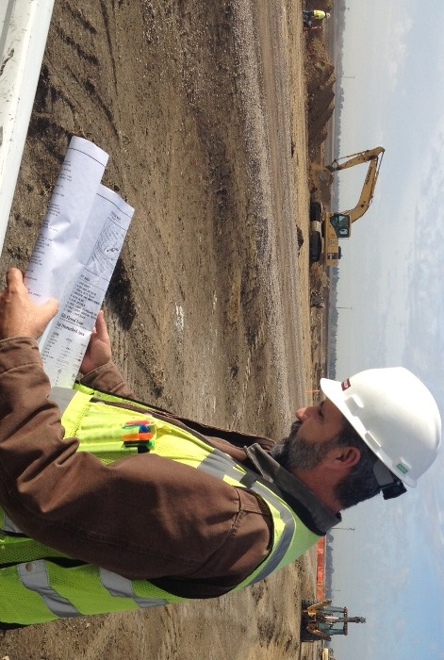
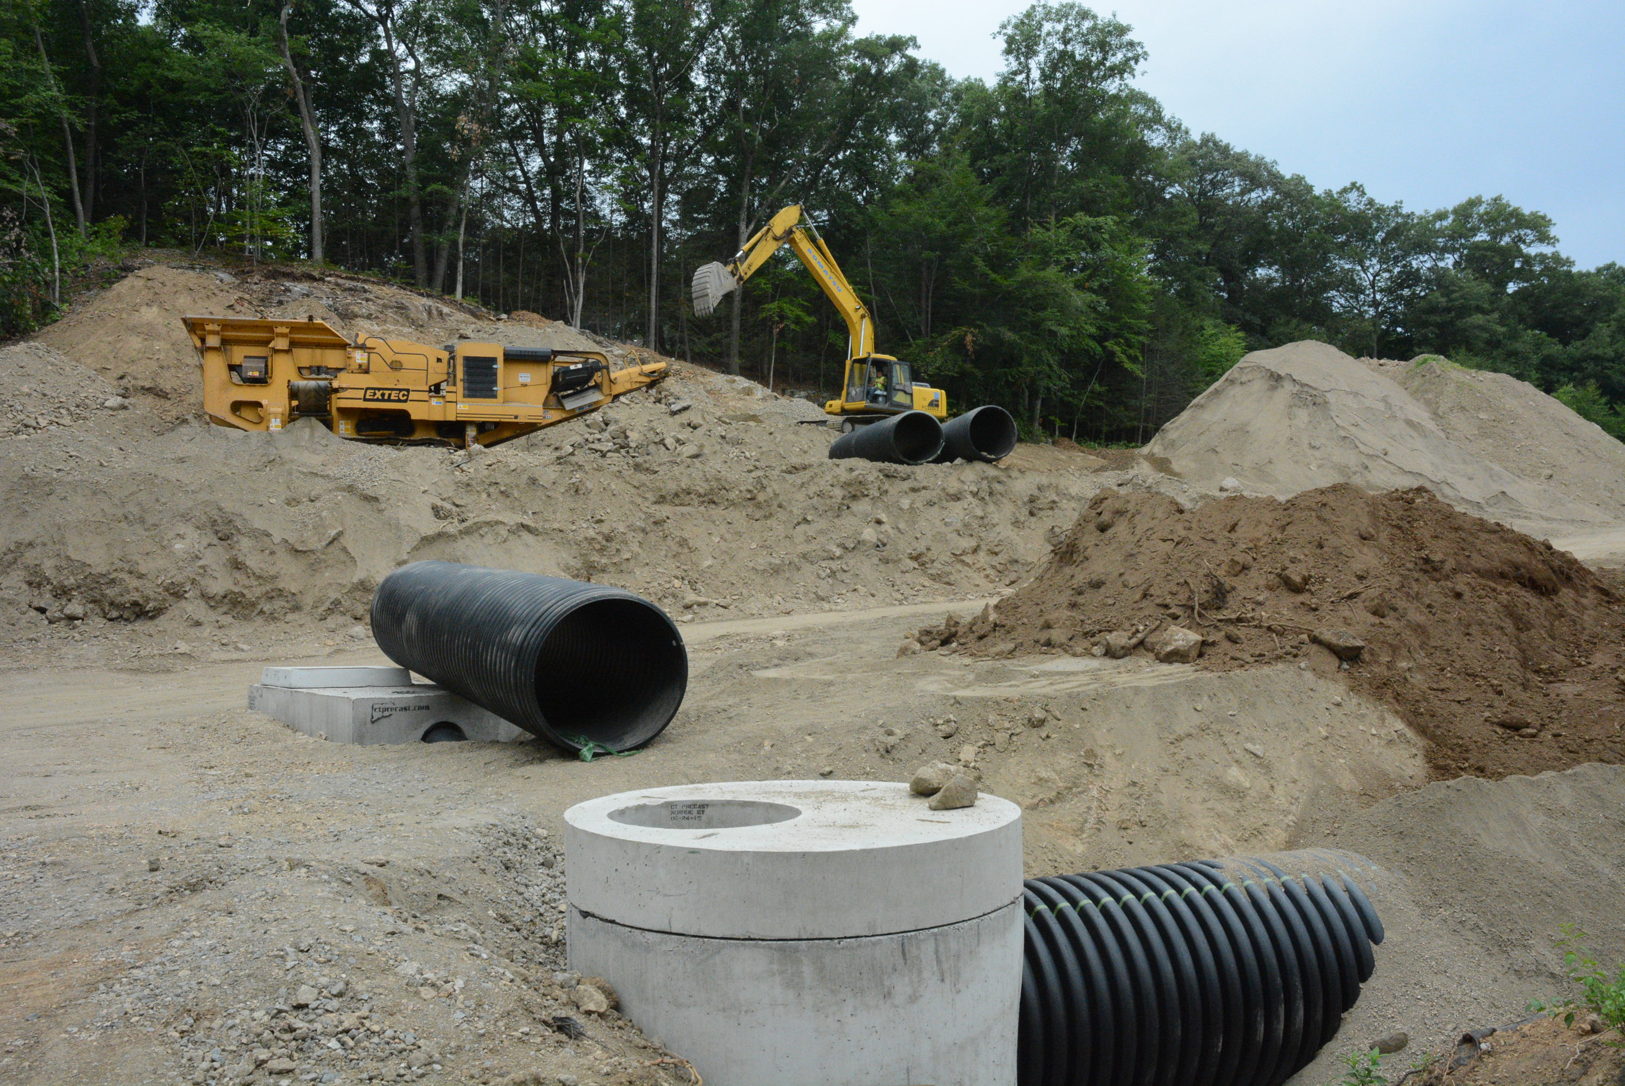
3 Regulatory Mechanisms
#3 Post-Construction
Use LID strategies
Follow Mass. SW Handbook stds.
New Development – design BMPs to:
Retain 1-inch storm over IA onsite
Remove 90% of TSS and 60% of phos.
Re-Development – design BMPs to:
Retain 0.8-inch storm over IA onsite
Remove 80% of TSS and 50% of phos.
Note, does not apply to minor road work
Submittal of as-builts
Long-term O&M
Image Credit: https://www.cityofsacramento.org/Public-Works/Engineering-Services/Programs-and-Services/Construction-Inspection-Services
Client Focused, Responsive, Quality Service • Experienced, Knowledgeable Technical Staff • Innovative, Cost Effective Designs

Slide 7
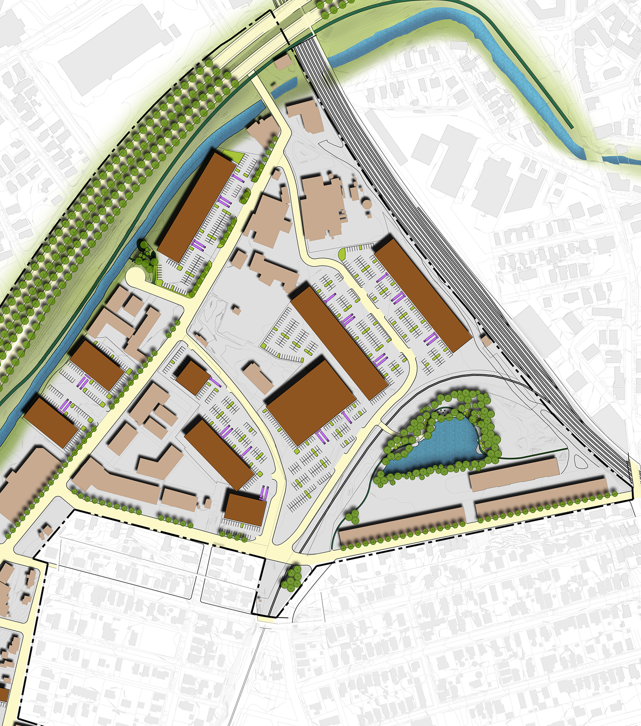
Applicability
IDDE Applies Everywhere
Others for Land Disturbance >1-Acre
Also Applies when Total Land Disturbance >1-Acre, e.g. Subdivisions
Does not apply unless you disturb >1 acre (likely N/A for additions, decks, pools, etc.)
Most impacts will be to subdivisions and large scale commercial sites, not single-family
Why Do This?
If not adopted, Town is in non-compliance
Fines, consent order, will have to do anyways
Image Credit: http://www.cssboston.com/wp-content/uploads/2013/09/TannerPlan.jpg
Client Focused, Responsive, Quality Service • Experienced, Knowledgeable Technical Staff • Innovative, Cost Effective Designs

Slide 8


Regulatory Components
1. Bylaw
Combine IDDE and Stormwater
Keep it brief
Establish legal authority and enforcement
Allow adoption of regulations
Who authorizes program – Board of Selectmen
Bylaw Adopted at Town Meeting – Final Version Complete
2. Regulations
Establish permit process and requirements
Detail and what needs to be done
Who manages program – Planning Board
Regs Adopted at PB Meeting – Draft Complete
Image Credit: https://www.wdam.com/2019/09/27/website-offers-free-legal-help-low-income-mississippians/
Image Credit: https://www.freedomworks.org/content/regulation-madness-coming-end
Client Focused, Responsive, Quality Service • Experienced, Knowledgeable Technical Staff • Innovative, Cost Effective Designs

Slide 9

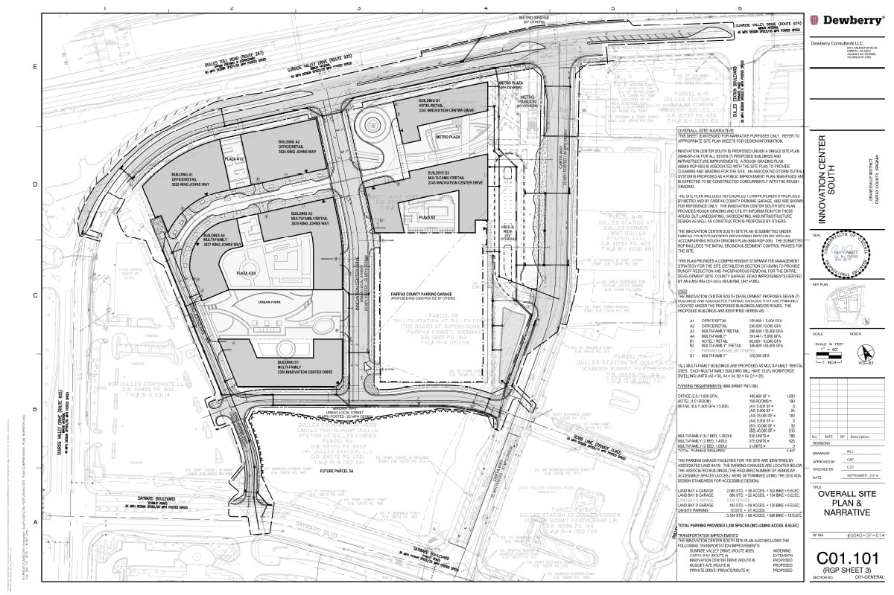
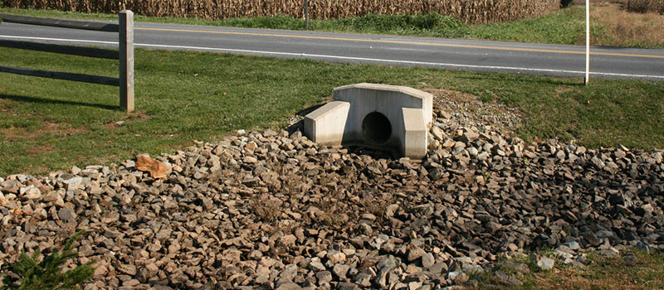
Comparison with Existing Regulations
Right Now - Town Doesn’t Have the 3 Required Regulations
Existing Regs (Site Plan, Subdiv., Wetland, etc.) Don’t Meet All Requirements
Required by 2008 Under Last Permit
Consent Decree to do Regulations
Due by June 30, 2021
Image Credit:
https://innovationcentersouth.com/development/site-plans/

Slide 10
Questions?
Comprehensive Environmental Incorporated
Board of Selectmen Meeting – April 5, 2021
Client Focused, Responsive, Quality Service • Experienced, Knowledgeable Technical Staff • Innovative, Cost Effective Designs

